Slide 1
Combinatorial Optimisation and Heuristics for Getting Around --PART 2-- Slides are (mostly) by: Phil Kilby Speaker today is: Charles Gretton

Slide 2
Outline
PART 1
Combinatorial Optimisation
The vehicle routing problem (VRP)
VRP Variants
Solving the Combinatorial Optimisation problems
Exact methods
Heuristic Construction
Auction
Local Search
Meta-heuristics
PART 2
Large Neighbourhood Search
A CP model for the VRP
Propagation
Large Neighbourhood Search revisited
Notes:
TSP game after 1st
CP model after 3
Carleton’s stuff after LNS

Slide 3
Large Neighbourhood Search
Originally developed by Paul Shaw (1997)
I teach the “adaptive” version, originally Ropke & Pisinger (2007)
A.k.a “Record-to-record” search
Destroy part of the solution
Remove visits from the solution
Re-create solution
Use favourite construct method to re-insert customers
If the solution is better, keep it
Repeat

Slide 4
Large Neighbourhood Search
Destroy part of the solution (Select method)
Remove some visits
Move them to the “unassigned” lists

Slide 5
Large Neighbourhood Search
Destroy part of the solution (Select method)
Examples
Remove a sequence of visits

Slide 6
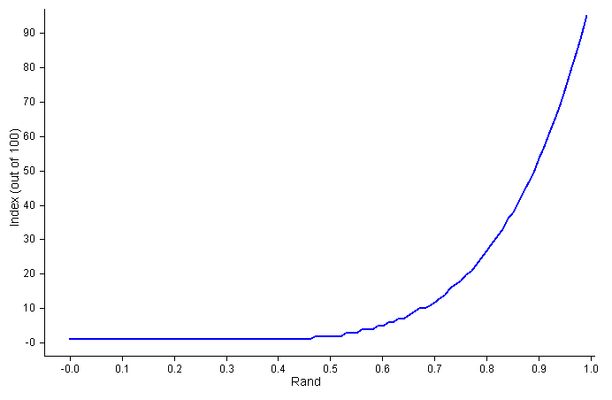
Large Neighbourhood Search
Destroy part of the solution (Select method)
Examples
Choose longest (worst) arc in solution
Remove visits at each end
Remove nearby visits
Actually, choose r^{th} worst
r = n * (uniform(0,1))^{y}
y ~ 6
0.5⁶ = 0.016
0.9⁶ = 0.531

Slide 7
Large Neighbourhood Search
Destroy part of the solution (Select method)
Examples
Dump visits from k routes (k = 1, 2, 3)
Prefer routes that are close,
Better yet, overlapping

Slide 8
Large Neighbourhood Search
Destroy part of the solution (Select method)
Examples
Choose first visit randomly
Then, remove “related” visits
Based on distance, time compatibility, load

Slide 9
Large Neighbourhood Search
Destroy part of the solution (Select method)
Examples
Dump visits from the smallest route
Good if saving vehicles
Sometimes fewer vehicles = reduced travel

Slide 10
Large Neighbourhood Search
Destroy part of the solution (Select method)
Parameter: Max to dump
As a % of n?
As a fixed number e.g. 100 for large problems
Actual number is uniform rand (5, max)

Slide 11
Large Neighbourhood Search
Re-create solution
Systematic search
Smaller problem, easier to solve
Can be very effective
E.g.: CP Backtracking search
Constraint: objective must be less than current
(Implicitly) Look at all reconstructions
Backtrack as soon as a better sol is found
Backtrack anyway after too many failures

Slide 12
Large Neighbourhood Search
Re-create solution
Use your favourite insert method
Better still, use a portfolio
Ropke: Select amongst
Minimum Insert Cost
Regret
3-regret
4-regret

Slide 13
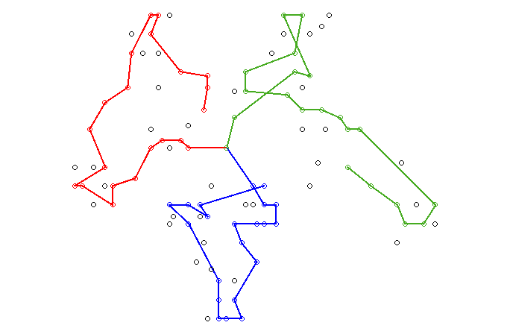
Large Neighbourhood Search
Notes:
X remove axis, b remove labels, q makes things square
Space to cycle through animation. Note that log of solver actions appears in textbox below animation.

Slide 14
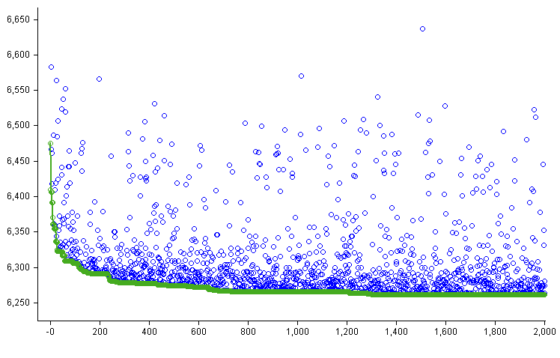
Large Neighbourhood Search
If the solution is better, keep it

Slide 15
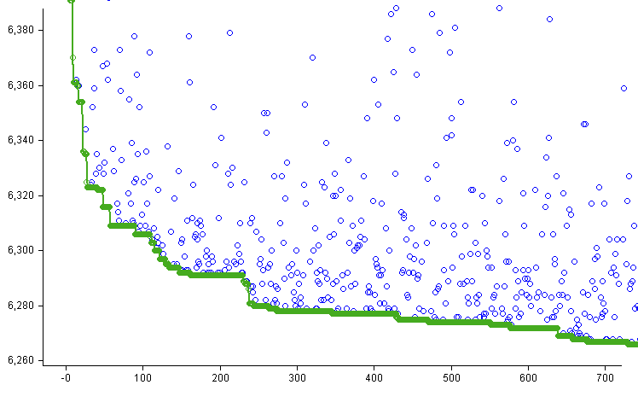
Large Neighbourhood Search
If the solution is better, keep it
Notes:
zoomed

Slide 16
Large Neighbourhood Search
If the solution is better, keep it
Can use Hill-climbing
Can use Simulated Annealing
Can use Threshold Annealing
…

Slide 17
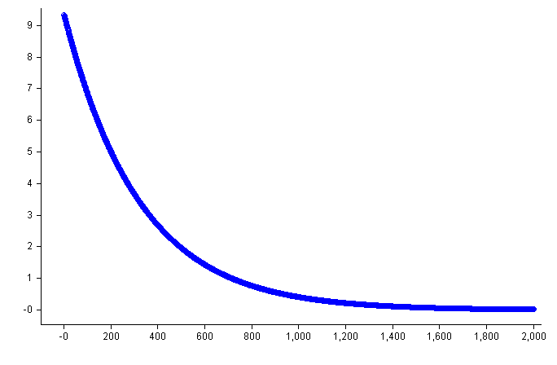
Large Neighbourhood Search

Slide 18
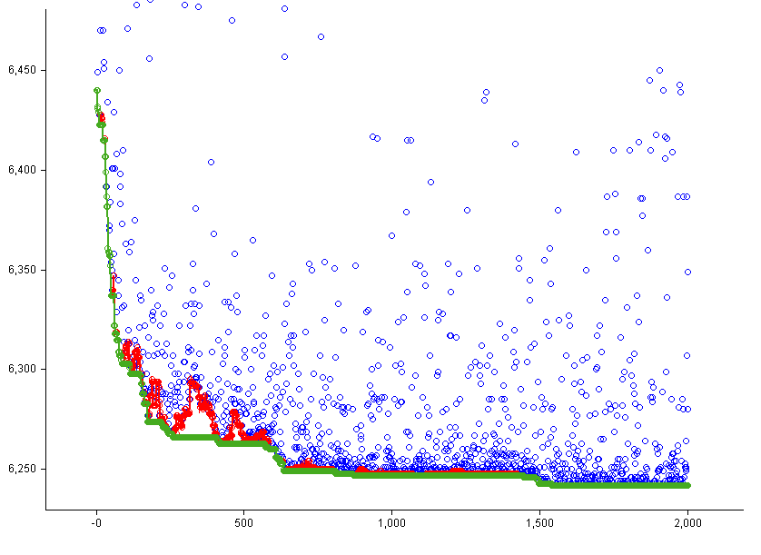
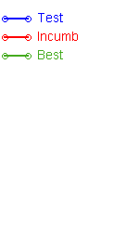
Large Neighbourhood Search

Slide 19
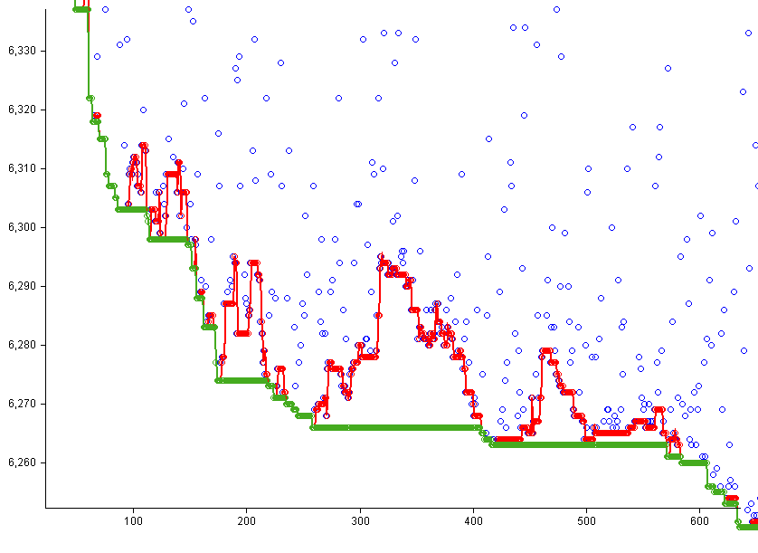
Large Neighbourhood Search
Notes:
zoom

Slide 20
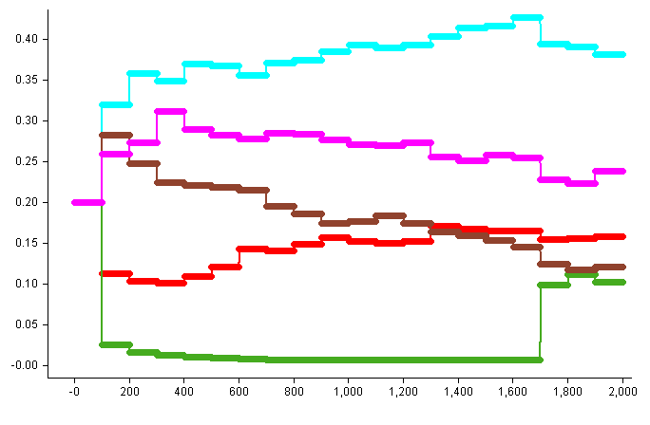
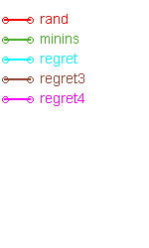
Large Neighbourhood Search
Adaptive
Ropke adapts choice based on prior performance
“Good” methods are chosen more often

Slide 21
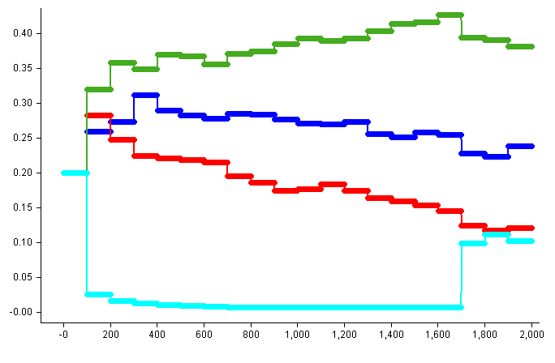
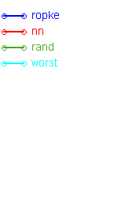
Large Neighbourhood Search
Adapting Select method (Selecting customers to remove)

Slide 22
Large Neighbourhood Search
Ropke & Pisinger (with additions) can solve a variety of problems
VRP
VRP + Time Windows
Pickup and Delivery
Multiple Depots
Multiple Commodities
Heterogeneous Fleet
Compatibility Constraints
Visual Attractiveness Soft Constraints:
http://users.cecs.anu.edu.au/~charlesg/
reveal.js/2014/VisuallyAttractive/
visually_attractive_routes.html#/

Slide 23
Solution Methods
What’s wrong with that?
New constraint → new code
Often right in the core
New constraints interact
e.g. Multiple time windows mess up duration calculation
Code is hard to understand, hard to maintain

Slide 24
Solution Methods
An alternative:
Constraint Programming
… after the break….

Slide 25
Constraint Programming
CP offers a language for representing problems
Decision variables
Constraints on variables
Also offers techniques for solving the problems
Systematic search
Heuristic Search

Slide 26
Constraint Programming for the VRP
Constraint Programming
Advantages:
Separate problem statement from data
Expressive language for formulating constraints
Each constraint encapsulated
Constraints interact naturally
Disadvantages:
Difficulty in representation
Can be slower

Slide 27
Constraint Programming
Two ways to use constraint programming
Rule Checker – i.e. validating the correctness of a solution
Properly – i.e. calculating a solution, or search artefact
Rule Checker:
Use favourite method to create/improve a solution
Check it with CP
Very inefficient.
Notes:
cg – I added a few i.e. things above, mainly as cues for myself.

Slide 28
A CP Model for the VRP

Slide 29
Model
A (rich) vehicle routing problem
n customers (fixed in this model)
m routes (fixed in this model)
fixed locations
where things happen
one for each customer + one for (each?) depot
c commodities (e.g. weight, volume, pallets)
Know demand from each customer for each commodity
Know time between each location pair
Know cost between each location pair
Both obey triangle inequality

Slide 30
Vocabulary
A solution is made up of routes (one for each vehicle)
A route is made up of a sequence of visits
Some visits serve a customer (customer visit)
(Some tricks)
Each route has a “start visit” and an “end visit”
Start visit is first visit on a route – location is depot
End visit is last visit on a route – location is depot
Also have an additional route – the unassigned route
Where visits live that cannot be assigned
Usual constraints (time, capacity, …) not applied

Slide 31
Referencing
Customers
Each customer has an index in N = {1..n}
Customers are ‘named’ in CP by their index
Routes
Each route has an index in M = {1..m}
Unassigned route has index 0
Routes are ‘named’ in CP by their index
Visits
Customer visit index same as customer index
Start visit for route k has index n + k ; aka start_{k}
End visit for route k has index n + m + k ; aka end_{k}

Slide 32
Referencing
Sets
N = {1 .. n} – customers
M = {1 .. m} – routes
R = M ∪ {0} – includes ‘unassigned’ route
S = {n+1 .. n+m} – start visits
E = {n+m+1 .. n+2m} – end visits
V = N ∪ S ∪ E – all visits
V^{S}= N ∪ S – visits that have a sensible successor
VE= N ∪ E – visits that have a sensible predecessor

Slide 33
Data
We know (note uppercase)
V_{i} The ‘value’ of customer i
D_{ik} Demand by customer i for commodity k
E_{i} Earliest time to start service at i
L_{i} Latest time to start service at i
Q_{jk} Capacity of vehicle j for commodity k
T_{ij} Travel time from visit i to visit j
C_{ij} Cost (w.r.t. objective) of travel from i to j

Slide 34
Basic Variables
Successor variables: s_{i}
s_{i} gives direct successor of i, i.e. the index of the next visit on the route that visits i
s_{i} ∈ VE for i in V^{S} s_{i} = 0 for i in E
Predecessor variables p_{i}
p_{i} gives the index of the previous visit in the route
p_{i} ∈ V^{S} for i in VE p_{i} = 0 for i in S
Redundant – but empirical evidence for its use
Route variables r_{i}
r_{i} gives the index of the route (vehicle) that visits i
r_{i} ∈ R
Notes:
TSP game after 1st
CP model after 3
Carleton’s stuff after LNS

Slide 35
Example
i | s_{i} | p_{i} | r_{i}
1 | 4 | 2 | 2
2 | 1 | 7 | 2
3 | 8 | 5 | 1
4 | 9 | 1 | 2
5 | 3 | 6 | 1
6 | 5 | 0 | 1
7 | 2 | 0 | 2
8 | 0 | 3 | 1
9 | 0 | 4 | 2
1
Route 2
4
Route 1
2
End visits
3
7
9
5
8
6
Start visits
Notes:
There is an issue here, with the end and starting visits being indexed by zero, and yet being given other indexes, wrt selected vehicle, in the earlier materials.

Slide 36
Other variables
Accumulation Variables
q_{ik} Quantity of commodity k after visit i
c_{i} Objective cost getting to i
For problems with time constraints
a_{i} Arrival time at i
t_{i} Start time at i (time service starts)
d_{i} Departure time at i
Actually, only t_{i} is required, but others allow for expressive constraints

Slide 37
What can we model?
Basic VRP
VRP with time windows
Multi-depot
Heterogeneous fleet
Open VRP (vehicle not required to return to base)
Requires “anywhere” location
Route end visits located at anywhere
distance FROM i TO anywhere = 0
Compatibility
Customers on different / same vehicle
Customers on/not on given vehicle
Pickup and Delivery problems

Slide 38
What can we model?
Variable load/unload times
by changing departure time relative to start time
Dispatch time constraints
e.g. limited docks
s_{i} for i in S is load-start time
Depot close time
Time window on end visits
Fleet size and mix
Add lots of vehicles
Need to introduce a ‘fixed cost’ for a vehicle
C_{ij} is increased by fixed cost for all i ∈ S, all j ∈ N

Slide 39
What cannot we model
cannot handle dynamic problems
Fixed domain for s, p, r vars
cannot introduce new visits post-hoc
E.g. optional driver break must be allowed at start
cannot handle multiple visits to same customer
‘Larger than truck-load’ problems
If qty is fixed, can have multiple visits / cust
Heterogeneous fleet is a pain
Can handle time- or vehicle-dependent travel times/costs with mods
Can handle Soft Constraints with mods

Slide 40
Objective
Want to minimize
sum of objective (c_{ij}) over used arcs, plus
value of unassigned visits
minimize
Cost of dropped visits
Cost of getting to visit i
Dummy route
Of unassigned visits
Notes:
Note, that here there is an opportunity cost which is the value of visits assigned to route_0 (the special route that does not run)

Slide 41
Basic constraints
Path ( S, E, { s_{i} | i ∈ V } )
AllDifferent ( { p_{i} | i ∈ VE } )
Accumulate obj.
Accumulate time
Time windows

Slide 42
Constraints
Load
Consistency

Slide 43
Solving
Pure CP
Assign to ‘successor’ variables
Form chains of visits
Decision 1: Which visit to insert (== variable choice)
Decision 2: Where to insert it (== value choice)
s₁= 4
1
4
s₂= 1
2
‘Rooted chain’ starts at Start
‘Free chain’ otherwise
Can reason about free chains but rooted chains easier
“last(k)” is last visit in chain starting at k
3
s₇= 2
7
9
5
s₅= 3
8
6
Notes:
This is a discussion about what happens when you have cronological backtgracking and restrict the choice variables to the 'successor' variables.

Slide 44
Propagation – Cycles
Subtour elimination
Rooted chains are fine
For free chains:
for any chain starting at j,
remove j from s_{last(j)}
Some CP libraries have built-ins
Comet: ‘circuit’
ILOG: Path constraint

Slide 45
Propagation – Capacity (assume +ve qtys)
Rooted Chain
For each visit i with p_{i} not bound
For each route k in domain of r_{i}
If spare space on route k won’t allow visit i
Remove k from r_{i}
Remove i from p_{end(k)}
Remove i from s_{last(start(k))}
Free chains
As above (pretty much)
Before adding visit to chain and increasing chain to load L
v = Count routes with free space ≥ L
c = Count free chains with load ≥ L
if c > v, cannot form chain, backtrack
Assume +ve qtys

Slide 46
Propagation – Time
Time Constraints:
Rooted chains:
For each route k
For each visit i in domain of s_{last(k)}
If vehicle cannot reach i before E_{i}
Remove k from r_{i}
Remove i from s_{last(start(k))}
Free chains:
Form “implied time window” from chain
Rest is as above

Slide 47
A gotchya: Chronological backtracking
Assign a successor
1
4
s₂= 4
2
3
s₇= 2
7
9
5
8
6

Slide 48
A gotchya: Chronological backtracking
Assign a successor
Cannot re-assign
Domains can only shrink
1
4
s₂= 1
2
3
s₇= 2
7
9
5
8
6

Slide 49
Gotchya Resolution
Assign a successor
s₁ = [2,3,4,5,8,9]
s₂ = [1,3,4,5]
s₃ = [1,2,4,5,8,9]
s₄ = [1,3,5,9]
s₅ = [1,2,3,4,8,9]
s₆ = [1,3,5,8]
s₇ = [1,2,3,5]
s₈ = [0]
s₉ = [0]
1
4
2
3
7
9
5
8
6

Slide 50
Gotchya Resolution
Assign a successor
s₁ = [3,4,5]
s₂ = [1,3,5]
s₃ = [1,2,4,5,8,9]
s₄ = [3,5,9]
s₅ = [1,2,3,4,8,9]
s₆ = [3,5,8]
s₇ = [2,3,5]
s₈ = [0]
s₉ = [0]
1
4
2
3
7
9
5
8
6

Slide 51
Gotchya Resolution
Assume: T_{i,j} = 1 for all i, j
TWs for 1-5 are are [1-3]
a₁ = [1,2,3]
a₂ = [1,2]
a₃ = [1,2,3]
a₄ = [2,3]
a₅ = [1,2,3]
a₆ = [0]
a₇ = [0]
a₈ = [0,1,2,3,4]
a₉ = [3,4]
1
4
2
3
7
9
5
8
6

Slide 52
Gotchya Resolution
Assume: T_{i,j} = 1 for all i, j
TWs for 1-5 are are [1-3]
a₁ = [2]
a₂ = [1]
a₃ = [1,2,3]
a₄ = [3]
a₅ = [1,2,3]
a₆ = [0]
a₇ = [0]
a₈ = [0,1,2,3,4]
a₉ = [4]
1
4
2
3
7
9
5
8
6

Slide 53
Propagation – an alternative
Alternative relies on knowledge of “incumbent” solution
Use shared data structure
Can use full insertion (insert into middle of ‘chain’)
CP System
Var/value choice
Incumbent Solution
Propagators

Slide 54
Propagation
Insertion ‘in the middle’
Propagators know incumbent solution
Essentially propagate partial order
Only propagate non-binding implications
e.g. don’t “set” s₁ s₂ here:
But 1 is removed from s₄ , s₆
Can calculate earliest start, latest start to bound start time
Can calculate feasible inserts, and update s vars appropriately
Strong propagation for capacity, time constraints
1
3
4
2
7
9
8
6

Slide 55
Insertion
Allows for maximum propagation
Allows constraints to influence solution progressively
e.g. Blood delivery constraints
Delivery within 20 minutes of pickup
As soon as one is fixed implication flows to other
e.g. Driver break
Extra request (a-priori) with time constraints that relate to other breaks
Special propagator that removes requests that cannot be inserted in a route without violating rules

Slide 56
Example
5 R(equests); 10 D(demands) @ each request; E(arliest) arrival time
L(atest) departure time; S(ervice) time, Q is vehicle capacity
 | R1 | R2 | R3 | R4 | R5 | R6 | R7 | R8 | R9
D(emand)_{i} | 10 | 10 | 10 | 10 | 10 | 0 | 0 | 0 | 0
E(arliest)_{i} | 20 | 20 | 20 | 20 | 20 | 0 | 0 | 0 | 0
L(atest)_{i} | 150 | 65 | 150 | 150 | 150 | 200 | 200 | 200 | 200
S(ervice)_{i} | 10 | 10 | 10 | 10 | 10 | 0 | 0 | 0 | 0
+ Request Compatibility
Different Routes: R2, R4
 | V1 | V2
Q(uantity)_{k} | 30 | 30
Notes:
cg – Naming some of these variables:
Qk – The capacity of the kth vehicle
Di - ??
Ei – Earliest arrival time
Li – Latest departure time
Si – the visit time?

Slide 57
Example
5 R(equests); 10 D(demands) @ each request; E(arliest) arrival time
L(atest) departure time; S(ervice) time, Q is vehicle capacity
 | R1 | R2 | R3 | R4 | R5 | R6 | R7 | R8 | R9
D_{i} | 10 | 10 | 10 | 10 | 10 | 0 | 0 | 0 | 0
E_{i} | 20 | 20 | 20 | 20 | 20 | 0 | 0 | 0 | 0
L_{i} | 150 | 65 | 150 | 150 | 150 | 200 | 200 | 200 | 200
S_{i} | 10 | 10 | 10 | 10 | 10 | 0 | 0 | 0 | 0
1
4
 | V1 | V2
Q_{k} | 30 | 30
3
2
+ Request Compatibility
Different Routes: R2, R4
8
6
7
5
9
Notes:
cg – Naming some of these variables:
Qk – The capacity of the kth vehicle
Di - ??
Ei – Earliest arrival time
Li – Latest departure time
Si – the visit time?

Slide 58
Initial
 | R1 | R2 | R3 | R4 | R5 | R6 | R7 | R8 | R9
s_{i} | 0,2-5, 8,9 | 0,1, 3-5,8,9 | 0-2 4,5,8,9 | 0-3,5, 8,9 | 0-4, 8,9 | 1-5 | 1-5 | 0 | 0
r_{i} | 0,1,2 | 0,1,2 | 0,1,2 | 0,1,2 | 0,1,2 | 1 | 1 | 2 | 2
t_{i} | 20-150 | 20-65 | 20-150 | 20-150 | 20-150 | 0 | 0 | 0-200 | 0-200
q_{i} | 0-30 | 0-30 | 0-30 | 0-30 | 0-30 | 0 | 0 | 0-30 | 0-30
1
4
3
2
5
9 7 8 6
Notes:
cg – I just changed R7, r_i to 1, and R8, r_i to 2

Slide 59
Initial
 | R1 | R2 | R3 | R4 | R5 | R6 | R7 | R8 | R9
s_{i} | 0,2-5, 8,9 | 0,1, 3-5,8,9 | 0-2 4,5,8,9 | 0-3,5, 8,9 | 0-4, 8,9 | 1-5 | 1-5 | 0 | 0
r_{i} | 0,1,2 | 0,1,2 | 0,1,2 | 0,1,2 | 0,1,2 | 1 | 1 | 2 | 2
t_{i} | 51-150 | 32-65 | 42-150 | 50-150 | 30-150 | 0 | 0 | 0-200 | 0-200
q_{i} | 0-30 | 0-30 | 0-30 | 0-30 | 0-30 | 0 | 0 | 0-30 | 0-30
1
4
Initial propagations (arrive time)
3
2
5
9 7 8 6

Slide 60
Initial
 | R1 | R2 | R3 | R4 | R5 | R6 | R7 | R8 | R9
s_{i} | 0, 3-5,8,9 | 0,1, 3-5,8,9 | 0-2 4,5,8,9 | 0,1 3,5,8,9 | 0,1 3,4,8,9 | 1-5 | 1-5 | 0 | 0
r_{i} | 0,1,2 | 0,1,2 | 0,1,2 | 0,1,2 | 0,1,2 | 1 | 1 | 2 | 2
t_{i} | 51-150 | 32-65 | 42-150 | 50-150 | 30-150 | 0 | 0 | 0-200 | 0-200
q_{i} | 0-30 | 0-30 | 0-30 | 0-30 | 0-30 | 0 | 0 | 0-30 | 0-30
1
4
Initial propagations (time windows)
3
2
5
9 7 8 6

Slide 61
Initial
 | R1 | R2 | R3 | R4 | R5 | R6 | R7 | R8 | R9
s_{i} | 0, 3-5,8,9 | 0,1, 3,5,8,9 | 0-2 4,5,8,9 | 0,1 3,5,8,9 | 0,1 3,4,8,9 | 1-5 | 1-5 | 0 | 0
r_{i} | 0,1,2 | 0,1,2 | 0,1,2 | 0,1,2 | 0,1,2 | 1 | 1 | 2 | 2
t_{i} | 51-150 | 32-65 | 42-150 | 50-150 | 30-150 | 0 | 0 | 0-200 | 0-200
q_{i} | 0-30 | 0-30 | 0-30 | 0-30 | 0-30 | 0 | 0 | 0-30 | 0-30
1
4
Initial propagations (compatibility constraint)
3
2
5
9 7 8 6

Slide 62
Initial
 | R1 | R2 | R3 | R4 | R5 | R6 | R7 | R8 | R9
s_{i} | 0, 3-5,8,9 | 0,1, 3,5,8,9 | 0-2 4,5,8,9 | 0,1 3,5,8,9 | 0,1 3,4,8,9 | 1-5 | 1-5 | 0 | 0
r_{i} | 0,1,2 | 0,1,2 | 0,1,2 | 0,1,2 | 0,1,2 | 1 | 1 | 2 | 2
t_{i} | 51-150 | 32-65 | 42-150 | 50-150 | 30-150 | 0 | 0 | 0-200 | 0-200
q_{i} | 0-30 | 0-30 | 0-30 | 0-30 | 0-30 | 0 | 0 | 0-30 | 0-30
1
4
Fix-point.
3
2
5
9 7 8 6

Slide 63
Choose R5 after R7 (start V2)
 | R1 | R2 | R3 | R4 | R5 | R6 | R7 | R8 | R9
s_{i} | 0, 3-5,8,9 | 0,1, 3,5,8,9 | 0-2 4,5,8,9 | 0,1 3,5,8,9 | 0,1 3,4,8,9 | 1-5 | 1-5 | 0 | 0
r_{i} | 0,1,2 | 0,1,2 | 0,1,2 | 0,1,2 | 0,1,2 | 1 | 1 | 2 | 2
t_{i} | 51-150 | 32-65 | 42-150 | 50-150 | 30-150 | 0 | 0 | 0-200 | 0-200
q_{i} | 0-30 | 0-30 | 0-30 | 0-30 | 0-30 | 0 | 0 | 0-30 | 0-30
1
4
3
2
5
9 7 8 6

Slide 64
Choose R5 after R7 (start V2)
 | R1 | R2 | R3 | R4 | R5 | R6 | R7 | R8 | R9
s_{i} | 0, 3-5,8,9 | 0,1, 3,5,8,9 | 0-2 4,5,8,9 | 0,1 3,5,8,9 | 0,1 3,4,8,9 | 1-4 | 1-5 | 0 | 0
r_{i} | 0,1,2 | 0,1,2 | 0,1,2 | 0,1,2 | 0,1,2 | 1 | 1 | 2 | 2
t_{i} | 51-150 | 32-65 | 42-150 | 50-150 | 30-150 | 0 | 0 | 0-200 | 0-200
q_{i} | 0-30 | 0-30 | 0-30 | 0-30 | 0-30 | 0 | 0 | 0-30 | 0-30
1
4
Propagate successor implications
3
2
5
9 7 8 6

Slide 65
Choose R5 after R7 (start V2)
 | R1 | R2 | R3 | R4 | R5 | R6 | R7 | R8 | R9
s_{i} | 0, 3-5,8,9 | 0,1, 3,5,8,9 | 0-2 4,5,8,9 | 0,1 3,5,8,9 | 0,1 3,4,9 | 1-4 | 1-5 | 0 | 0
r_{i} | 0,1,2 | 0,1,2 | 0,1,2 | 0,1,2 | 0,1,2 | 1 | 1 | 2 | 2
t_{i} | 51-150 | 32-65 | 42-150 | 50-150 | 30-150 | 0 | 0 | 0-200 | 60-200
q_{i} | 0-30 | 0-30 | 0-30 | 0-30 | 10-30 | 0 | 0 | 0-30 | 10-30
1
4
Propagate changes to time and load
3
2
5
9 7 8 6

Slide 66
Choose R5 after R7 (start V2)
 | R1 | R2 | R3 | R4 | R5 | R6 | R7 | R8 | R9
s_{i} | 0, 3-5,8,9 | 0,1, 3,5,8,9 | 0-2 4,5,8,9 | 0,1 3,5,8,9 | 0,1 3,4,9 | 1-4 | 1-5 | 0 | 0
r_{i} | 0,1,2 | 0,1,2 | 0,1,2 | 0,1,2 | 0,1,2 | 1 | 1 | 2 | 2
t_{i} | 51-150 | 32-65 | 42-150 | 50-150 | 30-150 | 0 | 0 | 0-200 | 60-200
q_{i} | 0-30 | 0-30 | 0-30 | 0-30 | 10-30 | 0 | 0 | 0-30 | 10-30
1
4
Bind route var
3
2
5
9 7 8 6

Slide 67
Choose R5 after R7 (start V2)
 | R1 | R2 | R3 | R4 | R5 | R6 | R7 | R8 | R9
s_{i} | 0, 3-5,8,9 | 0,1, 3,5,8,9 | 0-2 4,5,8,9 | 0,1 3,5,8,9 | 0,1 3,4,9 | 1-4 | 1-5 | 0 | 0
r_{i} | 0,1,2 | 0,1,2 | 0,1,2 | 0,1,2 | 2 | 1 | 1 | 2 | 2
t_{i} | 51-150 | 32-65 | 42-150 | 50-150 | 30-150 | 0 | 0 | 0-200 | 60-200
q_{i} | 0-30 | 0-30 | 0-30 | 0-30 | 10-30 | 0 | 0 | 0-30 | 10-30
1
4
Fix-point
3
2
5
9 7 8 6

Slide 68
Choose R2 after R7 (start V2)
 | R1 | R2 | R3 | R4 | R5 | R6 | R7 | R8 | R9
s_{i} | 0, 3-5,8,9 | 0,1, 3,5,8,9 | 0-2 4,5,8,9 | 0,1 3,5,8,9 | 0,1 3,4,9 | 1-4 | 1-5 | 0 | 0
r_{i} | 0,1,2 | 0,1,2 | 0,1,2 | 0,1,2 | 2 | 1 | 1 | 2 | 2
t_{i} | 51-150 | 32-65 | 42-150 | 50-150 | 30-150 | 0 | 0 | 0-200 | 60-200
q_{i} | 0-30 | 0-30 | 0-30 | 0-30 | 10-30 | 0 | 0 | 0-30 | 10-30
1
4
3
2
5
9 7 8 6

Slide 69
Choose R2 after R7 (start V2)
 | R1 | R2 | R3 | R4 | R5 | R6 | R7 | R8 | R9
s_{i} | 0, 3-5,8,9 | 1,3,5 | 0-2 4,5,8,9 | 0,1 3,5,8,9 | 1,3,4,9 | 1,3,4 | 1-4 | 0 | 0
r_{i} | 0,1,2 | 0,1,2 | 0,1,2 | 0,1,2 | 2 | 1 | 1 | 2 | 2
t_{i} | 51-150 | 32-65 | 42-150 | 50-150 | 30-150 | 0 | 0 | 0-200 | 60-200
q_{i} | 0-30 | 0-30 | 0-30 | 0-30 | 10-30 | 0 | 0 | 0-30 | 10-30
1
4
Propagate successor implications
3
2
5
9 7 8 6

Slide 70
Choose R2 after R7 (start V2)
 | R1 | R2 | R3 | R4 | R5 | R6 | R7 | R8 | R9
s_{i} | 0, 3-5,8,9 | 1,3,5 | 0-2 4,5,8,9 | 0,1 3,5,8,9 | 1,3,4,9 | 1,3,4 | 1-4 | 0 | 0
r_{i} | 0,1,2 | 0,1,2 | 0,1,2 | 0,1,2 | 2 | 1 | 1 | 2 | 2
t_{i} | 51-150 | 32-65 | 42-150 | 50-150 | 78-150 | 0 | 0 | 0-200 | 118-200
q_{i} | 0-30 | 10-30 | 0-30 | 0-30 | 20-30 | 0 | 0 | 0-30 | 20-30
1
4
Update load and time
3
2
5
9 7 8 6

Slide 71
Choose R2 after R7 (start V2)
 | R1 | R2 | R3 | R4 | R5 | R6 | R7 | R8 | R9
s_{i} | 0, 3-5,8,9 | 1,3,5 | 0-2 4,5,8,9 | 0,1 3,5,8,9 | 1,3,4,9 | 1,3,4 | 1-4 | 0 | 0
r_{i} | 0,1,2 | 0,1,2 | 0,1,2 | 0,1,2 | 2 | 1 | 1 | 2 | 2
t_{i} | 51-150 | 32-65 | 42-150 | 50-150 | 78-150 | 0 | 0 | 0-200 | 118-200
q_{i} | 0-30 | 10-30 | 0-30 | 0-30 | 20-30 | 0 | 0 | 0-30 | 20-30
1
4
Bind route var
3
2
5
9 7 8 6

Slide 72
Choose R2 after R7 (start V2)
 | R1 | R2 | R3 | R4 | R5 | R6 | R7 | R8 | R9
s_{i} | 0, 3-5,8,9 | 1,3,5 | 0-2 4,5,8,9 | 0,1,3,8 | 1,3,4,9 | 1,3,4 | 1-3 | 0 | 0
r_{i} | 0,1,2 | 2 | 0,1,2 | 0,1,2 | 2 | 1 | 1 | 2 | 2
t_{i} | 51-150 | 32-65 | 42-150 | 50-150 | 78-150 | 0 | 0 | 0-200 | 118-200
q_{i} | 0-30 | 10-30 | 0-30 | 0-30 | 20-30 | 0 | 0 | 0-30 | 20-30
1
4
Propagate request compatibility constraint
3
2
5
9 7 8 6

Slide 73
Choose R2 after R7 (start V2)
 | R1 | R2 | R3 | R4 | R5 | R6 | R7 | R8 | R9
s_{i} | 0, 3-5,8,9 | 1,3,5 | 0-2 4,5,8,9 | 0,1,3,8 | 1,3,9 | 1,3,4 | 1-3 | 0 | 0
r_{i} | 0,1,2 | 2 | 0,1,2 | 0,1 | 2 | 1 | 1 | 2 | 2
t_{i} | 51-150 | 32-65 | 42-150 | 50-150 | 78-150 | 0 | 0 | 0-200 | 118-200
q_{i} | 0-30 | 10-30 | 0-30 | 0-30 | 20-30 | 0 | 0 | 0-30 | 20-30
1
4
Fixpoint
3
2
5
9 7 8 6

Slide 74
Choose R3 after R2
 | R1 | R2 | R3 | R4 | R5 | R6 | R7 | R8 | R9
s_{i} | 0, 3-5,8,9 | 1,3,5 | 0-2 4,5,8,9 | 0,1,3,8 | 1,3,9 | 1,3,4 | 1-3 | 0 | 0
r_{i} | 0,1,2 | 2 | 0,1,2 | 0,1 | 2 | 1 | 1 | 2 | 2
t_{i} | 51-150 | 32-65 | 42-150 | 50-150 | 78-150 | 0 | 0 | 0-200 | 118-200
q_{i} | 0-30 | 10-30 | 0-30 | 0-30 | 20-30 | 0 | 0 | 0-30 | 20-30
1
4
3
2
5
9 7 8 6

Slide 75
Choose R3 after R2
 | R1 | R2 | R3 | R4 | R5 | R6 | R7 | R8 | R9
s_{i} | 0, 3-5,8,9 | 1,3,5 | 1,4,5 | 0,1,3,8 | 1,3,9 | 1,3,4 | 1,2 | 0 | 0
r_{i} | 0,1,2 | 2 | 0,1,2 | 0,1 | 2 | 1 | 1 | 2 | 2
t_{i} | 51-150 | 32-65 | 42-150 | 50-150 | 78-150 | 0 | 0 | 0-200 | 118-200
q_{i} | 0-30 | 10-30 | 0-30 | 0-30 | 20-30 | 0 | 0 | 0-30 | 20-30
1
4
Propagate successor implications
3
2
5
9 7 8 6

Slide 76
Choose R3 after R2
 | R1 | R2 | R3 | R4 | R5 | R6 | R7 | R8 | R9
s_{i} | 0, 3-5,8,9 | 1,3 | 1,4,5 | 0,1,3,8 | 1,9 | 1,4 | 1,2 | 0 | 0
r_{i} | 0,1,2 | 2 | 0,1,2 | 0,1 | 2 | 1 | 1 | 2 | 2
t_{i} | 51-150 | 32-65 | 62-110 | 50-150 | 102-150 | 0 | 0 | 0-200 | 142-200
q_{i} | 0-30 | 10-30 | 20-30 | 0-30 | 30 | 0 | 0 | 0-30 | 30
1
4
Update time and load
3
2
5
9 7 8 6

Slide 77
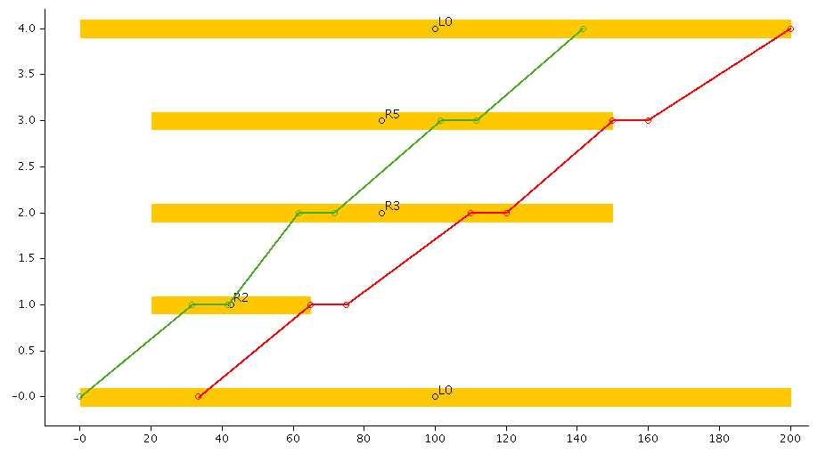
V1 schedule

Slide 78
Choose R3 after R2
 | R1 | R2 | R3 | R4 | R5 | R6 | R7 | R8 | R9
s_{i} | 0, 3-5,8,9 | 1,3 | 1,4,5 | 0,1,3,8 | 1,9 | 1,4 | 1,2 | 0 | 0
r_{i} | 0,1,2 | 2 | 0,1,2 | 0,1 | 2 | 1 | 1 | 2 | 2
t_{i} | 51-150 | 32-65 | 62-110 | 50-150 | 102-150 | 0 | 0 | 0-200 | 142-200
q_{i} | 0-30 | 10-30 | 20-30 | 0-30 | 30 | 0 | 0 | 0-30 | 30
1
4
Bind route var
3
2
5
9 7 8 6

Slide 79
Choose R3 after R2
 | R1 | R2 | R3 | R4 | R5 | R6 | R7 | R8 | R9
s_{i} | 0, 3-5,8,9 | 1,3 | 1,4,5 | 0,1,3,8 | 1,9 | 1,4 | 1,2 | 0 | 0
r_{i} | 0,1,2 | 2 | 2 | 0,1 | 2 | 1 | 1 | 2 | 2
t_{i} | 51-150 | 32-65 | 62-110 | 50-150 | 102-150 | 0 | 0 | 0-200 | 142-200
q_{i} | 0-30 | 10-30 | 20-30 | 0-30 | 30 | 0 | 0 | 0-30 | 30
1
4
Propagate request incompatibility constraint
3
2
5
9 7 8 6

Slide 80
Choose R3 after R2
 | R1 | R2 | R3 | R4 | R5 | R6 | R7 | R8 | R9
s_{i} | 0,4,8 | 1,3 | 5 | 0,1,8 | 1,9 | 1,4 | 1,2 | 0 | 0
r_{i} | 0,1,2 | 2 | 2 | 0,1 | 2 | 1 | 1 | 2 | 2
t_{i} | 51-150 | 32-65 | 62-110 | 50-150 | 102-150 | 0 | 0 | 0-200 | 142-200
q_{i} | 0-30 | 10-30 | 20-30 | 0-30 | 30 | 0 | 0 | 0-30 | 30
1
4
Propagate effects of full load
3
2
5
9 7 8 6

Slide 81
Choose R3 after R2
 | R1 | R2 | R3 | R4 | R5 | R6 | R7 | R8 | R9
s_{i} | 0,4,8 | 3 | 5 | 0,1,8 | 9 | 1,4 | 2 | 0 | 0
r_{i} | 0,1 | 2 | 2 | 0,1 | 2 | 1 | 1 | 2 | 2
t_{i} | 51-150 | 32-65 | 62-110 | 50-150 | 102-150 | 0 | 0 | 0-200 | 142-200
q_{i} | 0-30 | 10-30 | 20-30 | 0-30 | 30 | 0 | 0 | 0-30 | 30
1
4
Fix-point
3
2
5
9 7 8 6

Slide 82
Choose R4 after R6 (start V1)
 | R1 | R2 | R3 | R4 | R5 | R6 | R7 | R8 | R9
s_{i} | 0,4,8 | 3 | 5 | 0,1,8 | 9 | 1,4 | 2 | 0 | 0
r_{i} | 0,1 | 2 | 2 | 0,1 | 2 | 1 | 1 | 2 | 2
t_{i} | 51-150 | 32-65 | 62-110 | 50-150 | 102-150 | 0 | 0 | 0-200 | 142-200
q_{i} | 0-30 | 10-30 | 20-30 | 0-30 | 30 | 0 | 0 | 0-30 | 30
1
4
3
2
5
9 7 8 6

Slide 83
Choose R4 after R6 (start V1)
 | R1 | R2 | R3 | R4 | R5 | R6 | R7 | R8 | R9
s_{i} | 0,4,8 | 3 | 5 | 0,1,8 | 9 | 1,4 | 2 | 0 | 0
r_{i} | 0,1 | 2 | 2 | 0,1 | 2 | 1 | 1 | 2 | 2
t_{i} | 51-150 | 32-65 | 62-110 | 50-150 | 102-150 | 0 | 0 | 0-200 | 142-200
q_{i} | 0-30 | 10-30 | 20-30 | 0-30 | 30 | 0 | 0 | 0-30 | 30
1
4
Propagate successor implications
3
2
5
9 7 8 6

Slide 84
Choose R4 after R6 (start V1)
 | R1 | R2 | R3 | R4 | R5 | R6 | R7 | R8 | R9
s_{i} | 0,4,8 | 3 | 5 | 1,8 | 9 | 1,4 | 2 | 0 | 0
r_{i} | 0,1 | 2 | 2 | 0,1 | 2 | 1 | 1 | 2 | 2
t_{i} | 51-150 | 32-65 | 62-110 | 50-140 | 102-150 | 0 | 0 | 110-200 | 142-200
q_{i} | 0-30 | 10-30 | 20-30 | 10-30 | 30 | 0 | 0 | 10-30 | 30
1
4
Update time and load
3
2
5
9 7 8 6

Slide 85
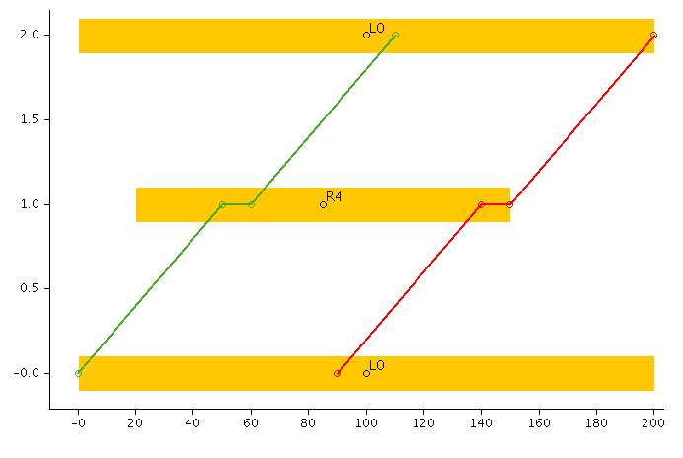
Choose R4 after R6 (start V1)

Slide 86
Choose R4 after R6 (start V1)
 | R1 | R2 | R3 | R4 | R5 | R6 | R7 | R8 | R9
s_{i} | 0,4,8 | 3 | 5 | 1,8 | 9 | 1,4 | 2 | 0 | 0
r_{i} | 0,1 | 2 | 2 | 0,1 | 2 | 1 | 1 | 2 | 2
t_{i} | 51-150 | 32-65 | 62-110 | 50-140 | 102-150 | 0 | 0 | 110-200 | 142-200
q_{i} | 0-30 | 10-30 | 20-30 | 10-30 | 30 | 0 | 0 | 10-30 | 30
1
4
Bind route var
3
2
5
9 7 8 6

Slide 87
Choose R4 after R6 (start V1)
 | R1 | R2 | R3 | R4 | R5 | R6 | R7 | R8 | R9
s_{i} | 0,4,8 | 3 | 5 | 1,8 | 9 | 1,4 | 2 | 0 | 0
r_{i} | 0,1 | 2 | 2 | 1 | 2 | 1 | 1 | 2 | 2
t_{i} | 51-150 | 32-65 | 62-110 | 50-140 | 102-150 | 0 | 0 | 110-200 | 142-200
q_{i} | 0-30 | 10-30 | 20-30 | 10-30 | 30 | 0 | 0 | 10-30 | 30
1
4
Fix-point
3
2
5
9 7 8 6

Slide 88
Choose R1 after R4
 | R1 | R2 | R3 | R4 | R5 | R6 | R7 | R8 | R9
s_{i} | 0,4,8 | 3 | 5 | 1,8 | 9 | 1,4 | 2 | 0 | 0
r_{i} | 0,1 | 2 | 2 | 1 | 2 | 1 | 1 | 2 | 2
t_{i} | 51-150 | 32-65 | 62-110 | 50-140 | 102-150 | 0 | 0 | 110-200 | 142-200
q_{i} | 0-30 | 10-30 | 20-30 | 10-30 | 30 | 0 | 0 | 10-30 | 30
1
4
3
2
5
9 7 8 6

Slide 89
Choose R1 after R4
 | R1 | R2 | R3 | R4 | R5 | R6 | R7 | R8 | R9
s_{i} | 0,4,8 | 3 | 5 | 1,8 | 9 | 1,4 | 2 | 0 | 0
r_{i} | 0,1 | 2 | 2 | 1 | 2 | 1 | 1 | 2 | 2
t_{i} | 51-150 | 32-65 | 62-110 | 50-140 | 102-150 | 0 | 0 | 110-200 | 142-200
q_{i} | 0-30 | 10-30 | 20-30 | 10-30 | 30 | 0 | 0 | 10-30 | 30
1
4
Propagate successor implications
3
2
5
9 7 8 6

Slide 90
Choose R1 after R4
 | R1 | R2 | R3 | R4 | R5 | R6 | R7 | R8 | R9
s_{i} | 8 | 3 | 5 | 1 | 9 | 4 | 2 | 0 | 0
r_{i} | 0,1 | 2 | 2 | 1 | 2 | 1 | 1 | 2 | 2
t_{i} | 70-139 | 32-65 | 62-110 | 50-119 | 102-150 | 0 | 0 | 131-200 | 142-200
q_{i} | 20-30 | 10-30 | 20-30 | 10-30 | 30 | 0 | 0 | 20-30 | 30
1
4
Update load and time, and route var
3
2
5
9 7 8 6

Slide 91
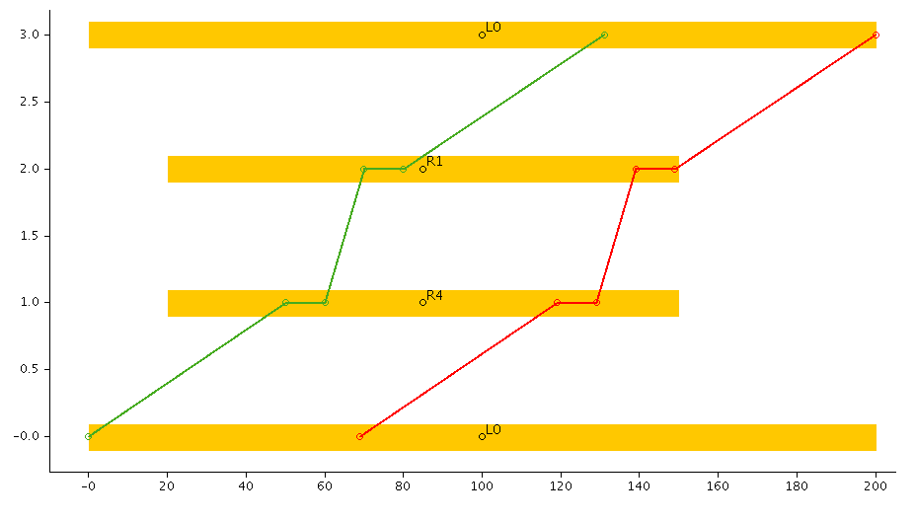
Choose R1 after R4

Slide 92
Choose R1 after R4
 | R1 | R2 | R3 | R4 | R5 | R6 | R7 | R8 | R9
s_{i} | 8 | 3 | 5 | 1 | 9 | 4 | 2 | 0 | 0
r_{i} | 1 | 2 | 2 | 1 | 2 | 1 | 1 | 2 | 2
t_{i} | 70-139 | 32-65 | 62-110 | 50-119 | 102-150 | 0 | 0 | 131-200 | 142-200
q_{i} | 20-30 | 10-30 | 20-30 | 10-30 | 30 | 0 | 0 | 20-30 | 30
1
4
Fix-point
3
2
5
9 7 8 6

Slide 93
Choose R1 after R4
 | R1 | R2 | R3 | R4 | R5 | R6 | R7 | R8 | R9
s_{i} | 8 | 3 | 5 | 1 | 9 | 4 | 2 | 0 | 0
r_{i} | 1 | 2 | 2 | 1 | 2 | 1 | 1 | 2 | 2
t_{i} | 70 | 32 | 62 | 50 | 102 | 0 | 0 | 131 | 142
q_{i} | 20 | 10 | 20 | 10 | 30 | 0 | 0 | 20 | 30
1
4
FINISHED! Bind remaining vars to min val
3
2
5
9 7 8 6

Slide 94
Local Search
Can apply std local search methods VRPs
k-opt
Or-opt
exchange
…
Step from solution to solution, so
CP is only used as rule-checker
Little use of propagation
But LNS is repeated insertion
Makes maximum use of propagation

Slide 95
Large Neighbourhood Search revisited

Slide 96
Large Neighbourhood Search
Destroy & Re-create
Destroy part of the solution
Remove visits from the solution
Re-create solution
Use insert method to re-insert customers
Different insert methods lead to new (better?) solutions
If the solution is better, keep it
Repeat

Slide 97
Large Neighbourhood Search
Destroy part of the solution (Select method)
In CP terms, this means:
Relax some variable assignments
In CP-VRP terms, this means
Relax some routeOf and successor assignments

Slide 98
Large Neighbourhood Search
Re-create solution
Use insert methods
Uses full power of CP propagations

Slide 99
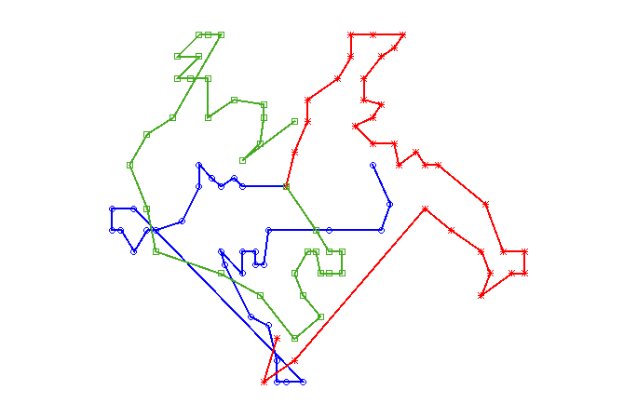
Advanced techniques – Re-create solution
Adaptive Decomposition
Decompose problem
Only consider 2-3 routes
Smaller problem is much easier to solve

Slide 100
Advanced – Re-create solution
Adaptive Decomposition
Decompose problem
Only consider 2-3 routes
Smaller problem is much easier to solve
Adaptive
Decompose in different ways
Use problem features to determine decomposition
Dependency graph analysis
[Acyclicity Bounds] Abdulaziz, Gretton and Norrish, ICAPS 2017
[Objective/Goal Decomposition] Rintanen and Gretton, IJCAI 2013
[HOL4 Proofs] Abdulaziz, Gretton and Norrish, JAR 2018
Symmetry:
[Quotient Problem] Abdulaziz, Gretton and Norrish, IJCAI 2015

Slide 101
Advanced techniques – Re-create solution
Limited Discrepancy Search
Heuristic order

Slide 102
Advanced techniques
Limited Discrepancy Search

Slide 103
Advanced techniques
Limited Discrepancy Search

Slide 104
Advanced techniques
Limited Discrepancy Search

Slide 105
Advanced techniques
2-LDS

Slide 106
Advanced techniques
2-LDS

Slide 107
Advanced techniques
2-LDS

Slide 108
Advanced techniques
2-LDS

Slide 109
Advanced techniques
2-LDS

Slide 110
Advanced techniques
Limited Discrepancy Search
Structured incomplete search
Budget of discrepancies
‘Spend’ a discrepancy by going against the heuristic

Slide 111
Solving VRPs
CP is “natural” for solving vehicle routing problems
Real problems often have unique constraints
Easy to change CP model to include new constraints
New constraints do not change core solve method
Infrastructure for complete (completish) search in subproblems
LNS is “natural” for CP
Insertion leverages propagation

Slide 112
Presenter’s Transportation Publications
H. Aziz, C. Cahan, C. Gretton, P. Kilby, N. Mattei and T. Walsh. A Study of Proxies for Shapley Allocations of Transport Costs. Journal of Artificial Intelligence Research 56:573-611, 2016.
H. Grzybowska, C. Gretton, P. Kilby, S. T. Waller. A Decision Support System for a Real-Time Field Service Engineer Scheduling Problem with Emergencies and Collaborations. Journal of the Transportation Research Board 2497:117-123. 2015.tificial Intelligence Research 56:573-611, 2016.
C. Gretton and P. Kilby. A Study of Shape Penalties in Vehicle Routing. TRISTAN VIII, 2013.

Slide 113
Presenter’s Local Search Publications
D. Pham, J. Thornton, C. Gretton, and A. Sattar. Combining Adaptive and Dynamic Local Search for Satisfiability. Journal on Satisfiability, Boolean Model Checking, and Computation, 2008.
S.Richter, M.Helmert and C.Gretton. A Stochastic Local Search Approach to Vertex Cover. Proceedings of the 30th German Conference on Artificial Intelligence (KI-2007), 2007.

