Slide 1
Logic for Verification 3
Nisansala Yatapanage
ANU Logic Summer School

Slide 2
Today’s lecture
We’ll look at the following:
LTL (linear temporal logic)
CTL (computation tree logic)
CTL*
Transition systems
Bisimulation

Slide 3
What is temporal logic?
Types of temporal logic include:
Linear Temporal Logic (LTL)
Computation Tree Logic (CTL)
CTL*
Lots of others too.
CTL*
CTL
LTL

Slide 4
What are States?
x = 4; y = 3
State after P2 (before P3)
Consider this program:
P1: int x = 4;
P2: int y = 3;
P3: if (x > 2){
P4: x = x + 2;
}
P5: y = y – 1;
P6: System.out.println(y);
P3
x = 4; y = 3
P4
x = 6; y = 3
State after P4
P5
Note: These states are not really identical – the program counter values are different (not shown here).
x = 6; y = 2
State after P5
P6
x = 6; y = 2
State after P6

Slide 5
What are States?
Consider this program:
P1: int x = 4
P2: boolean y = getInput();
P3: if (y){
P4: x = x + 2;
}
P5: y = false;
P6: System.out.println(x);
x = 4; y = true
x = 4; y = false
P3
P3
x = 4; y = true
x = 4; y = false
P4
P5
x = 6; y = true
x = 4; y = false
P5
P6
This time there are two possible traces:
x = 6; y = false
x = 4; y = false
P6
x = 6; y = false

Slide 6
State Transition Diagram
x = 4; y = true; pc1=2
Consider this program:
P1: int x = 4
P2: boolean y = getInput();
P3: if (y){
P4: x = x + 2;
}
P5: y = false;
x = 4; pc1=1
x = 4; y = false; pc1=2
x = 4; y = true; pc1=3
x = 4; y = false; pc1=3
x = 6; y = true; pc1=4
x = 4; y = false; pc1=5
x = 6; y = false; pc1=5

Slide 7
State Transition Diagram
Consider this program:
P1: int x = 4
P2: boolean y = getInput();
P3: if (y){
P4: System.out.println(x);
}
P5: y = false;
x = 4; pc1=1
x = 4; y = true; pc1=2
x = 4; y = false; pc1=2
x = 4; y = true; pc1=3
x = 4; y = false; pc1=3
x = 4; y = true; pc1=4
x = 4; y = false; pc1=5

Slide 8
States
For non-temporal logics, we are thinking of the value just at one point,
but for temporal logics, we need to think of the value across different points in time.
States
and so on...
s0
s1
s2
s3
s4
s5
x = 0
y = 0
x = 1
y = 0
x = 2
y = 0
x = 2
y = 1
x = 3
y = 1
and so on...

Slide 9
Simple Formulas
Yes
Does the property x = 0 hold at state s0?
No
Does the property x = 0 hold at state s2?
Does the property (x = 2 AND y = 0) hold at state s2?
Yes
s0
s1
s2
s3
s4
s5
and so on...
x = 0
y = 0
x = 1
y = 0
x = 2
y = 0
x = 2
y = 1
x = 3
y = 1
and so on...

Slide 10
Simple Formulas
Does the property (x = 0) hold on the execution trace starting at s0?
This means the property must hold at s0.
Yes
The rest of the states don’t matter because there was no G operator (explained soon!)
s0
s1
s2
s3
s4
s5
and so on...
x = 0
y = 0
x = 1
y = 0
x = 2
y = 0
x = 2
y = 1
x = 3
y = 1
and so on...

Slide 11
Simple Formulas
Does the property (x = 2) hold on the execution trace starting at s0?
No
Does the property (x = 0 AND y = 0) hold on the execution trace starting at s0?
Yes
Does the property (x = 2 AND y = 0) hold on the execution trace starting at s0?
No
s0
s1
s2
s3
s4
s5
and so on...
x = 0
y = 0
x = 1
y = 0
x = 2
y = 0
x = 2
y = 1
x = 3
y = 1
and so on...

Slide 12
A Simple Case Study
Case study: A microwave oven.
s0
s1
s2
door = closed
light = off
oven = idle
door = closed
light = on
oven = cooking
door = closed
light = on
oven = idle
Does (door = closed) hold on this transition system?
Assume that it means starting at the first state, s0.
Yes
Does (light = off) hold on this transition system?
Yes
No
Does (light = on) hold on this transition system?

Slide 13
Safety Properties
A labelled transition system is a tuple (S, I, A,→), where S
is a set of states, I is the set of initial states, A is a set of actions and
→⊆ S x A x S is the transition relation.
A Kripke Structure, is a tuple T = (S, AP, L, I, →), where S is a set of states, AP is a set of atomic propositions, L is a labelling function which labels each state with the set of atomic propositions that hold in that state, I is a set of initial states and →⊆ S x S is the transition relation.
A doubly-labelled transition system labels both states and actions.

Slide 14
Safety Properties
A labelled transition system is a tuple (S, I, A,→), where S
is a set of states, I is the set of initial states, A is a set of actions and
→⊆ S x A x S is the transition relation.
A Kripke Structure, is a tuple T = (S, AP, L, I, →), where S is a set of states, AP is a set of atomic propositions, L is a labelling function which labels each state with the set of atomic propositions that hold in that state, I is a set of initial states and →⊆ S x S is the transition relation.
A doubly-labelled transition system labels both states and actions.

Slide 15
CTL* Properties
A CTL* state formula ψ is defined as follows, where p ∈ AP is an atomic proposition, ψ₁ and ψ₂ are state formulas and φ is a path formula:
ψ = true | p | ψ₁ ∧ ψ₂ | ! ψ₁ | Eφ
A CTL* path formula is defined as follows, where φ1 and φ2 are path formulas and ψ is a state formula:
φ = ψ | φ₁ ∧ φ₂ | ! φ₁ | Xφ₁ | φ₁ U φ₂

Slide 16
CTL* Formulas
Let T = (S, AP, L, I, →) be a transition system. A CTL* state formula ψ holds in a state s ∈ S, denoted T, s ⊨ ψ, or simply s ⊨ ψ, according to the following, where ψ₁ and ψ₂ are CTL* state formulas and φ is a CTL* path formula:
s ⊨ true,
s ⊨ a ∈ AP iff a ∈ L (s),
s ⊨ ! ψ₁ iff s ⊭ ψ₁,
s ⊨ ψ₁ ∧ ψ₂ iff s ⊨ ψ₁ and s ⊨ ψ₂,
s ⊨ Eφ iff there exists a path π = < s₀, s₁, s₂, ... >, such that s₀ = s and π ⊨ φ.

Slide 17
CTL* Formulas
A CTL* path formula φ holds for a path π = < s₀, s₁, s₂, ... >, denoted π⊨φ, according to the following,
where φ₁ and φ₂ are CTL* path formulas and ψ₁ is a CTL* state formula:
π ⊨ ψ₁ iff s₀ ⊨ ψ₁,
π ⊨ φ₁ ∧ φ₂ iff π ⊨ φ₁ and π ⊨ φ₂,
π ⊨ ! φ₁ iff π ⊭ φ₁,
π ⊨ Xφ₁ iff π[s₁…] ⊨ φ₁,
π ⊨ φ₁ U φ₂ iff ∃j > 0 such that π[s_{j}…] ⊨ φ₂ and ∀i, where 0 ≤ i < j, π[s_{i}…] ⊨ φ₁.

Slide 18
CTL* Formulas
All LTL formulas implicitly hold over all paths.
All CTL path operators have to be preceded by an A or E.
Some formulas can be expressed in LTL but not CTL and vice versa.
FGp (liveness) is a valid LTL formula but cannot be expressed in CTL.
E(Xp ∧ XXq) can be expressed in CTL* but not in CTL.

Slide 19
CTL Formulas
p
p
p
p
p
EFp
AFp

Slide 20
CTL Formulas
p
p
p
p
p
p
p
p
p
p
p
p
EGp
AGp

Slide 21
Global Operator
G means Globally – holds on all states.
Does the property G(x = 0) hold on this execution trace?
No
Yes
Does the property G(y < 2) hold on this execution trace?
If the question doesn’t mention other states, assume it means s0.
s0
s1
s2
s3
s4
s5
and so on...
x = 0
y = 0
x = 1
y = 0
x = 2
y = 0
x = 2
y = 1
x = 3
y = 1
and so on with no further changes to y.

Slide 22
A Simple Case Study
s0
s1
s2
door = closed
light = off
oven = idle
door = closed
light = on
oven = cooking
door = closed
light = on
oven = idle
Compare that to the answers if there is a G operator:
Yes
Does G(door = closed) hold on this transition system?
No
Does G(light = off) hold on this transition system?
No
Does G(light = on) hold on this transition system?

Slide 23
A Simple Case Study
s0
s1
s2
door = closed
light = off
oven = idle
door = closed
light = on
oven = cooking
door = closed
light = on
oven = timeout
Does G((door = closed) AND (light = off)) hold on this transition system?
No
It is also violated at s2 but the counterexample stops at the first violation.
Counterexample: s0, s1.
This is because at s1 the property is violated.
G means look at all the states.

Slide 24
Case Study
Each of those traces corresponds to a possible path in the transition system.
Here is a more complex transition system for the oven:
door = closed
light = off
oven = idle
door = closed
light = on
oven = cooking
door = closed
light = off
oven = timeout
s2
s0
s1
door = open
light = on
oven = open
s3

Slide 25
Execution Traces
What are the possible execution traces?
Some are: s0, s1, s2, s0, ....
s0, s1, s3, s0, ....
and so on...
s0
s1
s2
s0
s1
door = closed
light = off
oven = idle
door = closed
light = on
oven = cooking
door = closed
light = off
oven = timeout
door = closed
light = off
oven = idle

Slide 26
Global Operator
G(door = closed) holds on the execution trace below, but does it hold for all the possible traces?
s0
s1
s2
s0
s1
door = closed
light = off
oven = idle
door = closed
light = on
oven = cooking
door = closed
light = off
oven = timeout
door = closed
light = off
oven = idle

Slide 27
Global Operator
When we ask: does G(door = closed) hold, we are talking about all the possible execution traces.
See whether you can find a trace where it doesn’t hold – if no such trace exists, the property holds. Otherwise, it is false and that trace is a counterexample.
s0
s1
s2
s0
s1
door = closed
light = off
oven = idle
door = closed
light = on
oven = cooking
door = closed
light = off
oven = timeout
door = closed
light = off
oven = idle

Slide 28
Global Operator
G(door = closed) holds on the execution trace below, but does it hold for all the possible traces?
What about this one below?
This is a counterexample. The property is false.
s0
s1
s3
s0
s1
door = closed
light = off
oven = idle
door = closed
light = on
oven = cooking
door = open
light = on
oven = open
door = closed
light = off
oven = idle

Slide 29
Global Operator
Yes
What about G(door = open OR door = closed)?
On every trace, on all the steps, either door = open or door = closed.
door = closed
light = off
oven = idle
door = closed
light = on
oven = cooking
door = closed
light = off
oven = timeout
s2
s0
s1
door = open
light = on
oven = open
s3

Slide 30
Future Operator
A new operator: F (Future or eventually).
Does F(x = 3) hold on the trace below?
Yes
Starting at s0, we can eventually get to a state where x = 3.
s0
s1
s2
s3
s4
s5
and so on...
x = 0
y = 0
x = 1
y = 0
x = 2
y = 0
x = 2
y = 1
x = 3
y = 1
and so on...

Slide 31
Future Operator
Does F(x = 2) hold on the trace below?
Yes
Starting at s0, we can eventually get to a state where x = 2.
What about G(F(x = 2))?
s0
s1
s2
s3
s4
s5
and so on...
x = 0
y = 0
x = 1
y = 0
x = 2
y = 0
x = 2
y = 1
x = 3
y = 1
and so on with no states where x = 2 again.

Slide 32
Future Operator
What about G(F(x = 2))?
Remember what we do for G(p) – the property p must hold on every state, not just the first one.
So at every state, check whether you can reach x = 2.
No – not from s4.
s0
s1
s2
s3
s4
s5
and so on...
x = 0
y = 0
x = 1
y = 0
x = 2
y = 0
x = 2
y = 1
x = 3
y = 1
and so on with no states where x = 2 again.

Slide 33
Future Operator
Yes
Does G(F(oven = idle) hold?
On every trace, on all the steps, eventually you can get to oven = idle.
door = closed
light = off
oven = idle
door = closed
light = on
oven = cooking
door = closed
light = off
oven = timeout
s2
s0
s1
door = open
light = on
oven = open
s3

Slide 34
Future Operator
G(F(oven = idle):
Here is one trace. The state s0 is continuously reached, so from any state, you can eventually reach oven = idle.
s0
s1
s2
s0
s1
door = closed
light = off
oven = idle
door = closed
light = on
oven = cooking
door = closed
light = off
oven = timeout
door = closed
light = off
oven = idle

Slide 35
Future Operator
This is called infinitely often.
G(F(oven = idle):
Here is another trace. The state s0 is continuously reached, so from any state, you can eventually reach oven = idle.
s0
s1
s3
s0
s1
door = closed
light = off
oven = idle
door = closed
light = on
oven = cooking
door = open
light = on
oven = open
door = closed
light = off
oven = idle

Slide 36
Future Operator
No
Does G(F(door = open) hold?
There is a counterexample!
door = closed
light = off
oven = idle
door = closed
light = on
oven = cooking
door = closed
light = off
oven = timeout
s2
s0
s1
door = open
light = on
oven = open
s3

Slide 37
Future Operator
G(F(door = open):
Here is the counterexample.
This trace can go on forever without reaching s3, where the door is open.
s0
s1
s2
s0
s1
door = closed
light = off
oven = idle
door = closed
light = on
oven = cooking
door = closed
light = off
oven = timeout
door = closed
light = off
oven = idle

Slide 38
Future Operator
Counterexamples for F always have an infinite cycle, because we have to show that something will never happen.
door = closed
light = off
oven = idle
door = closed
light = on
oven = cooking
door = closed
light = off
oven = timeout
s2
s0
s1
door = open
light = on
oven = open
s3

Slide 39
Counterexamples
A counterexample is an execution trace showing how the property is violated.
Look for the shortest counterexample if possible.
For properties like G(p) where p is an atomic proposition, then the counterexample is just a trace going up to the state where p does not hold.
Counterexamples must be full traces – start from the starting state.

Slide 40
Counterexamples
What is the counterexample for G(door=closed AND light=off)?
door = closed
light = off
oven = idle
door = closed
light = on
oven = cooking
door = closed
light = off
oven = timeout
s2
s0
s1
door = open
light = on
oven = open
s3

Slide 41
Counterexamples
What is the counterexample for G(door = closed AND light = off)?
s0 – door=closed; light=off; oven=idle
s1 – door=closed; light=on; oven=cooking
The property was violated!
Therefore the counterexample is: s0, s1.
Look for the first state where the conditions don’t hold and stop the trace there.

Slide 42
Counterexamples
What is the counterexample for
G(door=closed => (light=off OR oven = cooking))?
Proved!
door = closed
light = off
oven = idle
door = closed
light = on
oven = cooking
door = closed
light = off
oven = timeout
s2
s0
s1
door = open
light = on
oven = open
s3

Slide 43
Counterexamples
What is the counterexample for
G(door=closed => (light=off OR oven = cooking))?
Proved!
This is proved because on states s0 to s2, the door is closed and either the light is off or the oven is cooking. On state s3, the door is not closed, so the antecedent is false. Therefore, it doesn’t matter that the light is not off and the oven is not cooking.

Slide 44
Counterexamples
What is the counterexample for G(F(oven = timeout))?
door = closed
light = off
oven = idle
door = closed
light = on
oven = cooking
door = closed
light = off
oven = timeout
s2
s0
s1
door = open
light = on
oven = open
s3

Slide 45
Counterexamples
What is the counterexample for G(F(oven = timeout))?
s0 – door=closed; light=off; oven=idle
Counterexample:
s0, s1, s3, s0, … cycle with s1, s3, s0.
s1 – door=closed; light=on; oven=cooking
s3 – door=open; light=on; oven=open
s0 – door=closed; light=off; oven=idle
… continue as a cycle.
Counterexamples for F always need a cycle to show that it never reaches a state where the condition holds.

Slide 46
Implies with Globally
What about if it was G(x = 2 => y = 0)?
No
Does the property hold on the path below?
At s0, s1 and s2 it holds, but not at s3.
s0
s1
s2
s3
s4
s5
and so on...
x = 0
y = 0
x = 1
y = 0
x = 2
y = 0
x = 2
y = 1
x = 3
y = 1
and so on...

Slide 47
Implies with Globally
At s0, s1 and s2 it holds, but not at s3.
G(x = 2 => y = 0)
Counterexample: s0, s1, s2, s3.
Why does it hold at s0 and s1 when x is not 2? Remember how implies works.
s0
s1
s2
s3
s4
s5
and so on...
x = 0
y = 0
x = 1
y = 0
x = 2
y = 0
x = 2
y = 1
x = 3
y = 1
and so on with no further changes to x or y.

Slide 48
Implies with Future
G(x = 2 => F (y = 1))
Proved
From every state where x = 2 holds, we can eventually reach a state where y = 1 holds (sometimes it is the same state).
s0
s1
s2
s3
s4
s5
and so on...
x = 0
y = 0
x = 1
y = 0
x = 2
y = 0
x = 2
y = 1
x = 3
y = 1
and so on with no further changes to x or y.

Slide 49
Implies with Future
G(x = 0 => F (y = 0))
Proved
s0
s1
s2
s3
s4
s5
and so on...
x = 0
y = 0
x = 1
y = 0
x = 2
y = 0
x = 2
y = 1
x = 3
y = 1
and so on with no further changes to x or y.

Slide 50
Implies with Future
G(x = 0 => F (y = 0))
False
No way to get from this state where x = 0 to one where y = 0.
s0
s1
s2
s3
s4
s5
and so on...
x = 0
y = 0
x = 1
y = 0
x = 0
y = 1
x = 2
y = 1
x = 3
y = 1
and so on with no further changes to x or y.

Slide 51
Implies with Future
Yes
Does G(oven = idle => F(door = closed)) hold?
The only state where oven = idle is s0. From here, it is always possible to eventually reach a state where door = closed.
door = closed
light = off
oven = idle
door = closed
light = on
oven = cooking
door = closed
light = off
oven = timeout
s2
s0
s1
door = open
light = on
oven = open
s3

Slide 52
Implies with Future
Does G(door = closed => F(oven = open)) hold?
No
Counterexample: s0, s1, s2, then an infinite cycle with s0, s1, s2.
door = closed
light = off
oven = idle
door = closed
light = on
oven = cooking
door = closed
light = off
oven = timeout
s2
s0
s1
door = open
light = on
oven = open
s3

Slide 53
Implies with Future
Yes
Does G(door = closed => F(oven = timeout)) hold?
Even on paths that go through s3, s2 is always still reached.
door = closed
light = off
oven = idle
door = closed
light = on
oven = cooking
door = closed
light = off
oven = timeout
s1
s2
s0
door = open
light = on
oven = open
s3

Slide 54
Implies with Future
Does G(light = on => F(oven = cooking)) hold?
No
At s1, oven is already cooking, but from s3, we could keep missing oven = cooking. Counterexample: s0, s3, cycle s2, s0, s3.
door = closed
light = off
oven = idle
door = closed
light = on
oven = cooking
door = closed
light = off
oven = timeout
s1
s2
s0
door = open
light = on
oven = open
s3

Slide 55
Next Operator
Another new operator: X (NeXt).
If the formula has just an X by itself like this one, then you only look at the 2nd state (s1 in the example).
Does X(x = 1) hold on the trace below?
Yes
Starting at s0, in the next state, x = 1.
s0
s1
s2
s3
s4
s5
and so on...
x = 0
y = 0
x = 1
y = 0
x = 2
y = 0
x = 2
y = 1
x = 3
y = 1
and so on...

Slide 56
Implies with Next
What about if it was G(x = 2 => X(y = 1))?
Yes
Does the property hold on the trace below?
Find the states where x = 2 holds and then look at the next states after them.
s0
s1
s2
s3
s4
s5
and so on...
x = 0
y = 0
x = 1
y = 0
x = 2
y = 0
x = 2
y = 1
x = 3
y = 1
and so on with no changes to x or y.

Slide 57
Implies with Next
Now try G(y = 0 => X(y = 1))?
Does the property hold on the trace below?
Find the states where y = 0 holds and then look at the next states after them.
s0
s1
s2
s3
s4
s5
and so on...
x = 0
y = 0
x = 1
y = 0
x = 2
y = 0
x = 2
y = 1
x = 3
y = 1
and so on with no changes to x or y.

Slide 58
Implies with Next
Now try G(y = 0 => X(y = 1))?
No
Does the property hold on the trace below?
Counterexample: s0. At this state, y = 0 but on the next state, s1, y is not 1.
s0
s1
s2
s3
s4
s5
and so on...
x = 0
y = 0
x = 1
y = 0
x = 2
y = 0
x = 2
y = 1
x = 3
y = 1
and so on with no changes to x or y.

Slide 59
Implies with Next
Yes
Does G(oven = idle => X(door = closed)) hold?
The only state where oven = idle is s0. From here, the only next step is s1.
door = closed
light = off
oven = idle
door = closed
light = on
oven = cooking
door = closed
light = off
oven = timeout
s2
s0
s1
door = open
light = on
oven = open
s3

Slide 60
Implies with Next
No
Does G(door = closed => X(light = on)) hold?
At s0, light = on in the next state, but not at s1 or s2.
Counterexample: s0, s1, s2.
Alternative longer counterexample: s0, s1, s2, s0.
door = closed
light = off
oven = idle
door = closed
light = on
oven = cooking
door = closed
light = off
oven = timeout
s2
s0
s1
door = open
light = on
oven = open
s3

Slide 61
Implies with Next
Does G(light = off => X(oven = cooking)) hold?
No
Counterexample: s0, s1, s2, s0.
No cycle is needed for X.
door = closed
light = off
oven = idle
door = closed
light = on
oven = cooking
door = closed
light = off
oven = timeout
s2
s0
s1
door = open
light = on
oven = open
s3

Slide 62
Until Operator
U (Until) p U q – p holds until q holds.
Does (y = 0) U (x = 2) hold on the trace below?
Yes
y = 0 holds on all states until it reaches a state where x = 2 holds (s2).
s0
s1
s2
s3
s4
s5
and so on...
x = 0
y = 0
x = 1
y = 0
x = 2
y = 0
x = 2
y = 1
x = 3
y = 1
and so on with no further changes to x and y.

Slide 63
Until Operator
Does (y = 0) U (x = 4) hold on the trace below?
No
Remember that if the second clause (x = 4) doesn’t ever hold, then the property is false.
s0
s1
s2
s3
s4
s5
and so on...
x = 0
y = 0
x = 1
y = 0
x = 2
y = 0
x = 2
y = 1
x = 3
y = 1
and so on with no further changes to x and y.

Slide 64
Until Operator
Does G((y = 0) U (x = 2)) hold on the trace below?
No
From any state, y should stay 0 until x is 2.
Is this true at s4?
How about s5?
s0
s1
s2
s3
s4
s5
and so on...
x = 0
y = 0
x = 1
y = 0
x = 2
y = 0
x = 2
y = 1
x = 2
y = 1
x = 3
y = 1
x = 2
y = 1
and so on with no further changes to x and y.

Slide 65
Until Operator
Does G(x = 1 => ((y = 0) U (x = 2))) hold on the trace below?
Yes
We’re only interested in looking at s1. From here, y stays 0 until x is 2.
s0
s1
s2
s3
s4
s5
and so on...
x = 0
y = 0
x = 1
y = 0
x = 2
y = 0
x = 2
y = 1
x = 2
y = 1
x = 3
y = 1
x = 2
y = 1
and so on with no further changes to x and y.

Slide 66
Until
Yes
Does G(light = off U oven = cooking) hold?
The light stays off until s1, where the oven is cooking.
door = closed
light = off
oven = idle
door = closed
light = on
oven = cooking
door = closed
light = off
oven = timeout
s2
s0
s1

Slide 67
Until
Does G(light = off U oven = cooking) hold?
No
Counterexample: s0, s3, s1.
door = closed
light = off
oven = idle
door = closed
light = on
oven = cooking
door = closed
light = off
oven = timeout
s1
s2
s0
door = open
light = on
oven = open
s3

Slide 68
Implies with Until
Does G(oven = open => (light = on U oven = timeout)) hold?
Yes
door = closed
light = off
oven = idle
door = closed
light = on
oven = cooking
door = closed
light = off
oven = timeout
s1
s2
s0
door = open
light = on
oven = open
s3

Slide 69
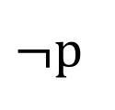
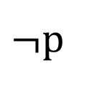
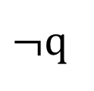
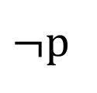

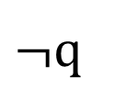
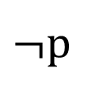
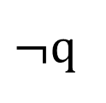
LTL Operators Overview
G(p) – p must hold on every state.
p
p
p
p
p
G(p => q) – on every state, if p holds then q holds.
Remember that it doesn’t matter whether q holds or not on the states where p doesn’t hold.
$¬$p
$¬$p
$¬$p
p
$¬$p
$¬$q
$$q$$
$¬$q
q
$¬$q

Slide 70
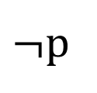
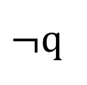
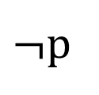
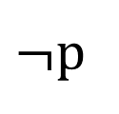
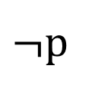
LTL Operators Overview
F(p) – p must eventually hold. There must be a state in the future where p holds.
$¬$p
$¬$p
$¬$p
p
G(p => F(q)) – on every state, if p holds then eventually q holds.
p doesn’t have to hold in the same state as q but it can.
$¬$p
p
$¬$p
$¬$p
$¬$p
$¬$q
$¬$q
$¬$q
q
$¬$q

Slide 71
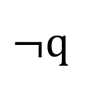
LTL Operators Overview
X(p) – p must hold on the next state.
If there’s no G then it just means the next state after the starting state.
p
G(p => X(q)) – on every state, if p holds then in the next state q holds.
$¬$p
p
$¬$p
p
$¬$p
$¬$q
$¬$q
q
$¬$q
q

Slide 72
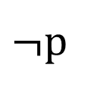
LTL Operators Overview
p U q – p must hold until q holds.
p
p
p
q
G(p U q) – from every state, p must hold until q holds.
Remember that from every state, q must hold eventually.
p
p
$¬$p
$¬$p
$¬$p
$¬$q
$¬$q
q
q
q

Slide 73
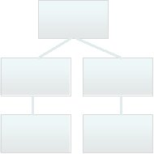
Behavior Trees
R1. There is a single control button available for the user of the oven. If the oven is idle with the door closed and you push the button, the oven will start cooking (this is, energize the power-tube for one minute).
R2. If the button is pushed while the oven is cooking it will cause the oven to cook for an extra minute.
R1. There is a single control button available for the user of the oven. If the oven is idle with the door closed and you push the button, the oven will start cooking (this is, energize the power-tube for one minute).
R2. If the button is pushed while the oven is cooking it will cause the oven to cook for an extra minute.
Requirement Behavior Trees
Informal
Requirements
Integration
Integrated Behavior Tree

Slide 74
Behavior Tree Syntax
State-realisation
Selection
Guard
Internal Input Event
Internal Output Event
External Input Event
External Output Event

Slide 75
Behavior Tree Syntax
Door
??? Closed ???
R1
When the door is open,
the light goes off.
Light
[ Off ]
R1
Oven
[ Ready]
R1

Slide 76
Behavior Trees
Behavior Trees is a language for writing about the requirements of a system.
Door
??? Closed ???
Microwave Oven requirement 1:
R1
When the door is closed, the light should go off and the oven goes into an idle state.
Light
[ Off ]
R1
Oven
[ Idle ]
R1

Slide 77
Behavior Trees
Oven
[ Idle ]
Microwave Oven requirement 2:
R1
When the oven is idle, when the button is pushed, the light should go on and the oven should begin cooking.
Button
??? Pushed ???
R1
Light
[ On ]
R1
Oven
[ Cooking ]
R1

Slide 78
Behavior Trees
Oven
[ Cooking ]
R1
Door
??? Open ???
Button
??? Pushed ???
Oven
??? Timeout ???
R1
R1
Oven
[ Increase time ]
Light
[ Off ]
Oven
[ Idle ]
R1
R1
R1
Oven ^
[ Cooking ]
Oven
[ Idle ]
R1
R1

Slide 79
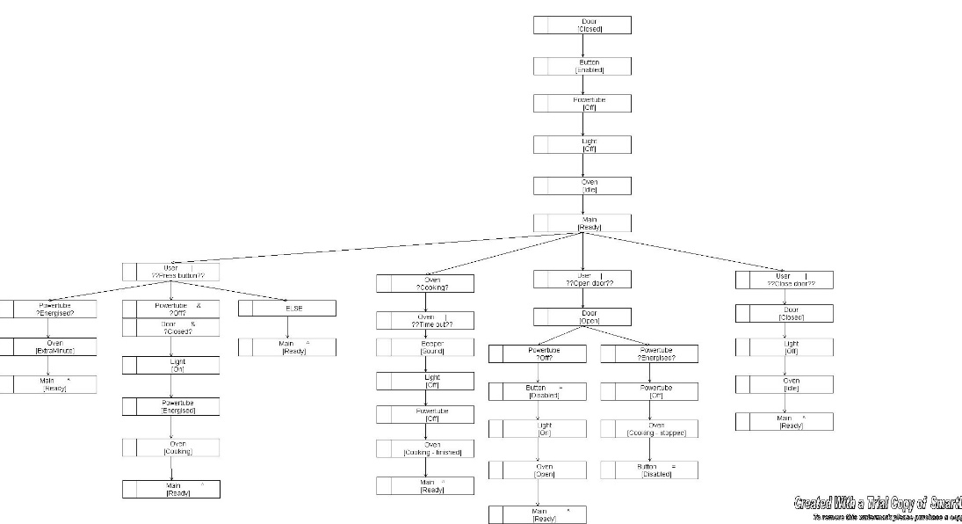
Making the System
Requirements
Design
Implementation (Software)
public void closeDoor(){
door.closeDoor();
light.turnOff();
}

Slide 80
A Safety-Critical System
Top sensor low
The motor is off. The plunger is at the bottom.
PONR sensor high
The user has released the button.
Bottom sensor high

Slide 81
A Safety-Critical System
Top sensor low
The motor turns on. The plunger starts rising.
PONR sensor high
The user has released the button.
Bottom sensor low

Slide 82
A Safety-Critical System
Top sensor low
The motor turns on. The plunger starts rising.
PONR sensor low
The user has released the button.
Bottom sensor low

Slide 83
A Safety-Critical System
Top sensor low
The motor turns on. The plunger starts rising.
PONR sensor low
The user has released the button.
Bottom sensor low

Slide 84
A Safety-Critical System
Top sensor high
The motor stays on.
The plunger stays at the top.
PONR sensor low
The user has released the button.
Bottom sensor low

Slide 85
A Safety-Critical System
Top sensor high
The motor stays on.
The plunger stays at the top.
PONR sensor low
The user pushes the button.
Bottom sensor low

Slide 86
A Safety-Critical System
Top sensor low
The motor turns off.
The plunger starts falling.
PONR sensor low
The user pushes the button.
Bottom sensor low

Slide 87
A Safety-Critical System
Top sensor low
Safety abort:
The user releases the button.
PONR sensor low
The motor turns back on.
The plunger rises again.
Bottom sensor low

Slide 88
A Safety-Critical System
Top sensor high
Safety abort:
The user releases the button below the PONR.
PONR sensor low
The plunger is falling below the PONR. The motor is off.
Bottom sensor low

Slide 89
A Safety-Critical System
Top sensor low
The user releases the button.
PONR sensor high
DANGER: The motor cannot turn on below the Point-of-no-return.
Bottom sensor low

Slide 90
A Safety-Critical System
Top sensor low
The user releases the button.
PONR sensor high
DANGER: The motor cannot turn on below the Point-of-no-return.
Bottom sensor low

Slide 91
A Safety-Critical System
Top sensor low
The user releases the button.
PONR sensor high
The plunger reaches the bottom and immediately starts rising again.
Bottom sensor high

Slide 92
The System
Motor
Plunger
Controller
Top sensor
PONR sensor
Button
Bottom sensor
Operator

Slide 93
Communicating by Message-Passing
Concurrent processes can communicate by shared-variable or message passing.
The plunger falls below the PONR.
The PONR sensor detects this and changes to the high state (modelled by the plunger sending a message out to the PONR sensor).
The PONR sensor sends a message to the controller.

Slide 94
Example Trace
Example trace:
Plunger = falling
Plunger = atBottom
BottomSensor = high
Controller reads BottomSensor
Controller sends out TurnOn message to the motor
Motor = on
Plunger = risingBelowPONR
BottomSensor = low
Plunger = risingAbovePONR
PONRSensor = low

Slide 95
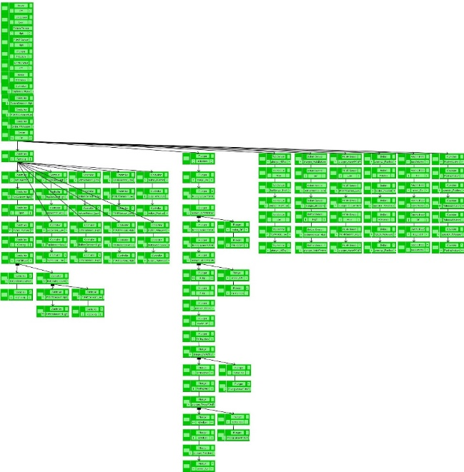

Model checking
Safety property in natural language
Temporal logic specification
Th1: Uncommanded closing: Plunger should not start falling without the operator pressing the button.
Th2: Motor on below PONR: The motor should not turn on when the plunger is falling below the PONR.
Th3: Loss of abort: If the plunger is falling above the PONR and the operator releases the button, the motor should turn on.
Th4: Plunger falling before reaching the top: The motor should not turn off unless the plunger is at the top.
th1: THEOREM behavior |- G((plunger=plunger_at_top AND operator=operator_released_button) => (electric_Motor=electric_Motor_on));
th2: THEOREM behavior |- G((plunger=plunger_falling_fast) => (electric_Motor=electric_Motor_off));
th3: THEOREM behavior |- G(F(plunger=plunger_falling_fast)) => G((plunger=plunger_falling_slow AND operator=operator_released_button) => U(plunger=plunger_falling_slow, electric_Motor=electric_Motor_on));
th4: THEOREM behavior |- G(NOT((plunger=plunger_rising_below_PONR OR plunger=plunger_rising_above_PONR) AND (electric_Motor=electric_Motor_off)));
Proved
Model checker
Specification
Counterexample

Slide 96
Safety Properties
Th1: Uncommanded closing: The plunger should not start falling without the operator pressing the button.
Th2: Motor on below PONR: The motor should not turn on when the plunger is falling below the PONR.
Th3: Loss of abort: If the plunger is falling above the PONR and the operator releases the button, the motor should turn on.
Th4: Plunger falling before reaching the top: The motor should not turn off unless the plunger is at the top.

Slide 97
Safety Properties
Th1: Uncommanded closing: The plunger should not start falling without the operator pressing the button.
G((plunger = atTop AND operator = releasedButton) => (electric_Motor = on));

Slide 98
Safety Properties
Th2: Motor on below PONR: The motor should not turn on when the plunger is falling below the PONR.
G((plunger = fallingFast) => (electric_Motor = off));

Slide 99
Safety Properties
Th3: Loss of abort: If the plunger is falling above the PONR and the operator releases the button, the motor should turn on.
G((plunger = fallingSlow AND operator = releasedButton) =>
F(electric_Motor = on));
G((plunger = fallingSlow AND operator = releasedButton) =>
(plunger = fallingSlow U electric_Motor = on));

Slide 100
Safety Properties
Th4: Plunger falling before reaching the top: The motor should not turn off unless the plunger is at the top.
G(NOT((plunger = risingBelowPONR OR plunger = risingAbovePONR) AND (electric_Motor = off)));

Slide 101
What can go wrong?
Top sensor low
Everything looks ok. What can go wrong?
What if the sensors are broken?
PONR sensor high
What if the Bottom Sensor is stuck high?
Bottom sensor high

Slide 102
Bottom Sensor stuck high
Top sensor low
The motor is off. The plunger is at the bottom.
PONR sensor high
The user has released the button.
Bottom sensor high

Slide 103
Bottom Sensor stuck high
Top sensor low
The motor turns on. The plunger starts rising.
PONR sensor high
The user has released the button.
Bottom sensor high

Slide 104
Bottom Sensor stuck high
Top sensor low
The motor turns on. The plunger starts rising.
PONR sensor low
The user has released the button.
Bottom sensor high

Slide 105
Bottom Sensor stuck high
Top sensor low
The motor turns on. The plunger starts rising.
PONR sensor low
The user has released the button.
Bottom sensor high

Slide 106
Bottom Sensor stuck high
Top sensor high
The motor stays on.
The plunger stays at the top.
PONR sensor low
The user has released the button.
Bottom sensor high

Slide 107
Bottom Sensor stuck high
Top sensor low
The plunger starts falling. The controller thinks it has reached the bottom and turns on the motor.
PONR sensor low
The user pushes the button.
No hazard, but the plunger won’t fall.
Bottom sensor high

Slide 108
Bottom Sensor stuck high half-way
Top sensor low
What if the bottom sensor breaks after the plunger has fallen below the PONR?
The user is still pushing the button.
PONR sensor high
The controller thinks the plunger reached the bottom and turns on the motor.
Bottom sensor high

Slide 109
Bottom Sensor stuck high half-way
Top sensor low
DANGER: The motor cannot turn on below the Point-of-no-return.
PONR sensor high
Bottom sensor high

Slide 110
Bottom Sensor stuck high
Th2: Motor on below PONR: The motor should not turn on when the plunger is falling below the PONR.
The bottom sensor problem can violate Th2.
This is a serious safety hazard.
Another failure that can cause this is the PONR sensor stuck low.

Slide 111
Safety Properties
Th2: Motor on below PONR: The motor should not turn on when the plunger is falling below the PONR.
G((plunger = fallingFast) => (electric_Motor = off));
Counterexample: The plunger is falling fast, then the bottom sensor turns high, the controller reads the bottom sensor as high and turns on the motor.

Slide 112
PONR Sensor stuck low
Top sensor low
The motor is off. The plunger is at the bottom.
PONR sensor low
The user has released the button.
Bottom sensor high

Slide 113
PONR Sensor stuck low
Top sensor low
The motor turns on. The plunger starts rising.
PONR sensor low
The user has released the button.
Bottom sensor high

Slide 114
PONR Sensor stuck low
Top sensor low
The motor turns on. The plunger starts rising.
PONR sensor low
The user has released the button.
Bottom sensor high

Slide 115
PONR Sensor stuck low
Top sensor low
The motor turns on. The plunger starts rising.
PONR sensor low
The user has released the button.
Bottom sensor high

Slide 116
PONR Sensor stuck low
Top sensor high
The motor stays on.
The plunger stays at the top.
PONR sensor low
The user has released the button.
Bottom sensor high

Slide 117
PONR Sensor stuck low
Top sensor low
The motor turns off. The plunger starts falling.
PONR sensor low
The user pushes the button.
Bottom sensor high

Slide 118
PONR Sensor stuck low
Top sensor low
The user releases the button.
PONR sensor low
The controller thinks the plunger is still above the PONR and allows the abort. The motor turns on.
Bottom sensor high

Slide 119
PONR Sensor stuck low
Top sensor low
DANGER: The motor cannot turn on below the Point-of-no-return.
PONR sensor low
Bottom sensor high

Slide 120
Safety Properties
Th2: Motor on below PONR: The motor should not turn on when the plunger is falling below the PONR.
G((plunger = fallingFast) => (electric_Motor = off));
Counterexample when the PONR sensor is stuck low: The plunger is falling fast, then the operator releases the button. The controller reads the PONR sensor value as low and thinks it is ok to turn on the motor. The controller turns on the motor.

Slide 121
What else can happen?
From: Grunske, L., Lindsay, P., Yatapanage, N. and Winter, K. (2005). An Automated Failure Mode and Effect Analysis based on High-Level Design Specification with Behavior Trees. Integrated Formal Methods: 5th International Conference (IFM 2005), Proc., Lecture Notes in Computer Science. Springer-Verlag. 3771:129-149.

Slide 122
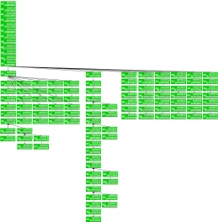
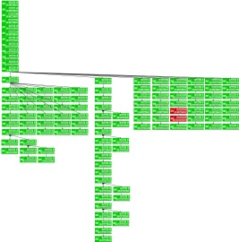

Behavior Tree Syntax
Safety and Security
Requirements
Formalised Temporal
Logic Formulae
Identified unsafe behaviours
Th1: Uncommanded closing: Plunger should not start falling without the operator pressing the button.
Th2: Motor on below PONR: The motor should not turn on when the plunger is falling below the PONR.
Th3: Loss of abort: If the plunger is falling above the PONR and the operator releases the button, the motor should turn on.
Th4: Plunger falling before reaching the top: The motor should not turn off unless the plunger is at the top.
th1: THEOREM behavior |- G((plunger=plunger_at_top AND operator=operator_released_button) => (electric_Motor=electric_Motor_on));
th2: THEOREM behavior |- G((plunger=plunger_falling_fast) => (electric_Motor=electric_Motor_off));
th3: THEOREM behavior |- G(F(plunger=plunger_falling_fast)) => G((plunger=plunger_falling_slow AND operator=operator_released_button) => U(plunger=plunger_falling_slow, electric_Motor=electric_Motor_on));
th4: THEOREM behavior |- G(NOT((plunger=plunger_rising_below_PONR OR plunger=plunger_rising_above_PONR) AND (electric_Motor=electric_Motor_off)));
Automatic Model
Checking
System Model with Injected
Component Fault Modes
Either…
Hazard has occurred
System Model
Or …
Proved
Component Fault
Modes

Slide 123
Program Slicing
Control
flow
Program
Control
Flow Graph
Dependencies
Slice
Program
Dependence
Graph
Criterion

Slide 124
Slicing of BTs
Control
flow
Behavior
Tree
CFG-BT
Dependencies
Slice
BTDG
LTL-X
Property

Slide 125
BT-Control Flow Graph
A BT-CFG is similar to a BT except:
Selections, guards and input events have an additional branch to show the false behaviour.
Sensor
? High ?
Sensor
? High ?
False
True
END
Pump
[ Off ]
Pump
[ Off ]
Reversion / reference nodes are replaced by edges.

Slide 126
Control Dependence
Node q is control-dependent on node p iff:
p has at least 2 successors m and n, where NOT(Alt(m,n)) and NOT(Conc(m,n)),
for all maximal paths from m, q always occurs and
there exists a maximal path from n on which q never occurs.
Control dependence occurs if p is a guard, selection or input event.

Slide 127
Program Slicing
Automatically removes parts of the program which are irrelevant to a given criterion.
Originally developed by Weiser (1981) for debugging programs.
Start at a slicing criterion and then follow back dependencies, e.g. control & data dependencies.

Slide 128
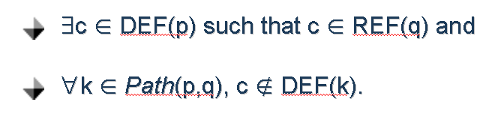
Data Dependence
Node q is data/interference-dependent on node p iff:
Data dependence = same thread
Interference dependence = parallel threads
Interference dependence is intransitive, so can lead to less precise, but still correct slices.

Slide 129
Other Dependencies
Node q is message-dependent on node p iff:
type(p) = internalOutput and behavior(q) = m
type(p) = internalInput and behavior(q) = m.
Node q is synchronisation-dependent on node p iff:
flag(p) = flag(q) = synchronisation and
matching(p,q).
Node q is alternate-dependent on node p iff:
p and q have the same parent node and
p and q are connected by an alternate branching point.

Slide 130
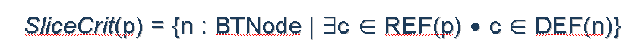
Creating the Slice
Start at nodes which modify variables that are in the property.
Traverse BTDG backwards, collecting all the nodes encountered.

Slide 131
Creating the Slice
Re-form into a Behavior Tree by adding blank place-holder nodes.
Put reversions and reference nodes back into the slice, unless the entire sub-tree is not in the slice.
Put for-all and for-some nodes back into the slice, unless the parameter is no longer used in the sub-tree below.

Slide 132
Bisimulation
Strong Bisimulation – matches every step
– preserves full CTL*
Too restrictive for some applications,
e.g. slicing, where a model is reduced by eliminating stuttering
–
CTL*
CTL
LTL

Slide 133
Weak Bisimulation
Weak forms of bisimulation
– do not match every step
– are suitable for applications like slicing
– do not preserve the X operator
e.g. Branching bisimulation with explicit divergence
- preserves CTL*_{-X}
However, the next operator is useful in practice
- e.g. for safety properties such as failure => X(set-alarm)

Slide 134
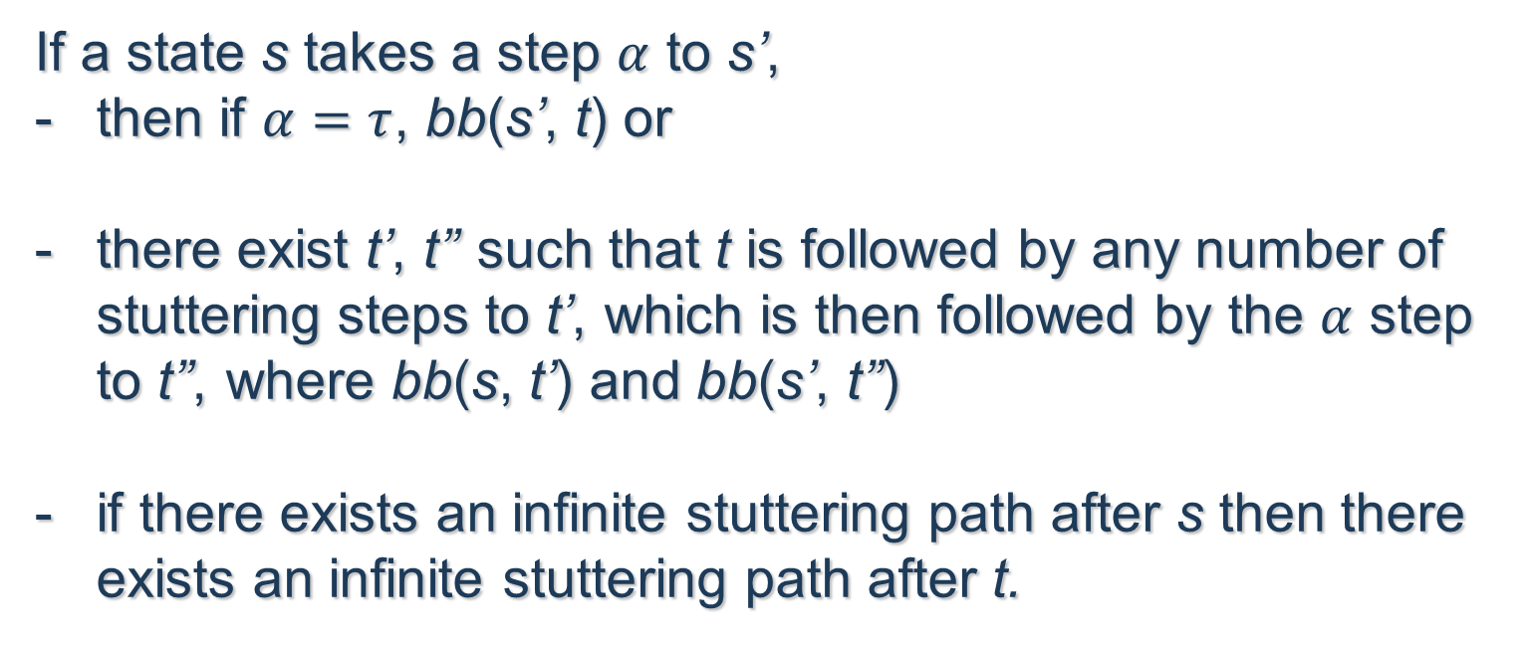
Branching Bisimulation with Explicit Divergence
If a state s takes a step $α$ to s’,
then if $α=τ$, bb(s’, t) or
there exist t’, t’’ such that t is followed by any number of stuttering steps to t’, which is then followed by the $α$ step to t’’, where bb(s, t’) and bb(s’, t’’)
if there exists an infinite stuttering path after s then there exists an infinite stuttering path after t.
The relation is symmetric.
It is defined so that branching logics can be preserved.
- It preserves CTL*-X.

Slide 135
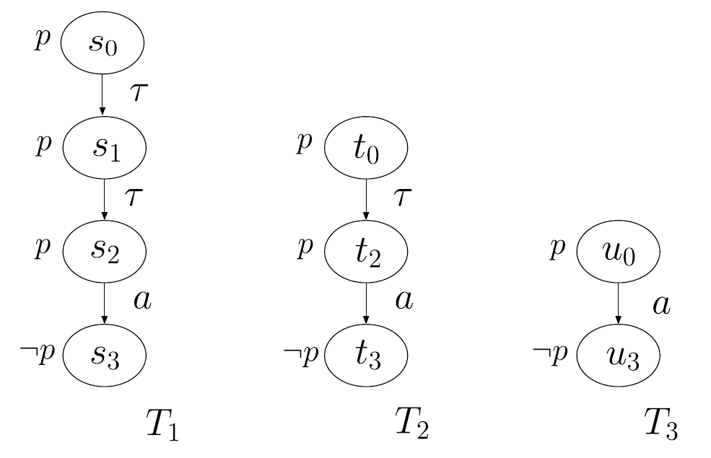
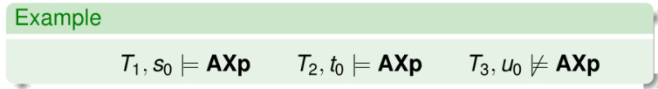
Eliminating Stuttering

Slide 136
Eliminating Stuttering
In the previous example, all three transition systems are related by branching bisimulation, but they don’t satisfy the same properties with X.
- shows that the stuttering before an observable step is important.

Slide 137
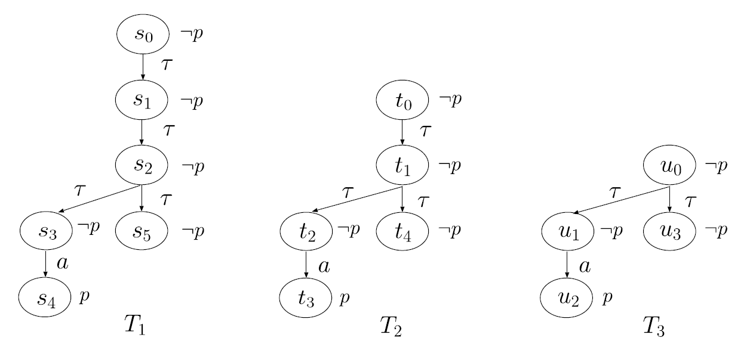
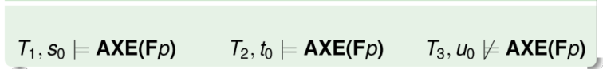
Eliminating Stuttering

Slide 138
Observable Steps
These examples illustrate the notion of observable step.
An observable step is one which either:
performs an observable (non-stuttering) action,
passes a critical branching point, or
performs a relevant stuttering step with respect to a particular formula.
Branching bisimulation covers only observable actions and critical branching points (called bb-observable steps).
Next-preserving branching bisimulation additionally considers relevant stuttering steps.

Slide 139
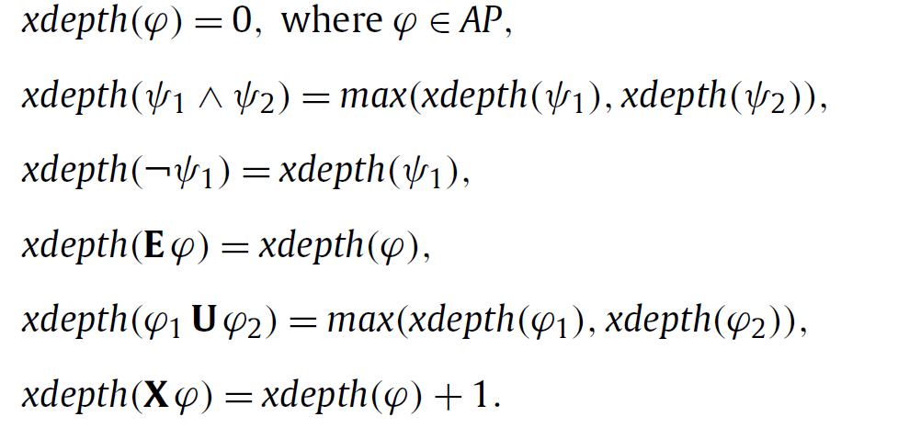
Relevant Stuttering Steps
The relevant stuttering steps are the ones which must be preserved, determined according to the xdepth of a formula:
e.g. xdepth(Xp) = 1
xdepth((Xp) U (XXq)) = 2

Slide 140
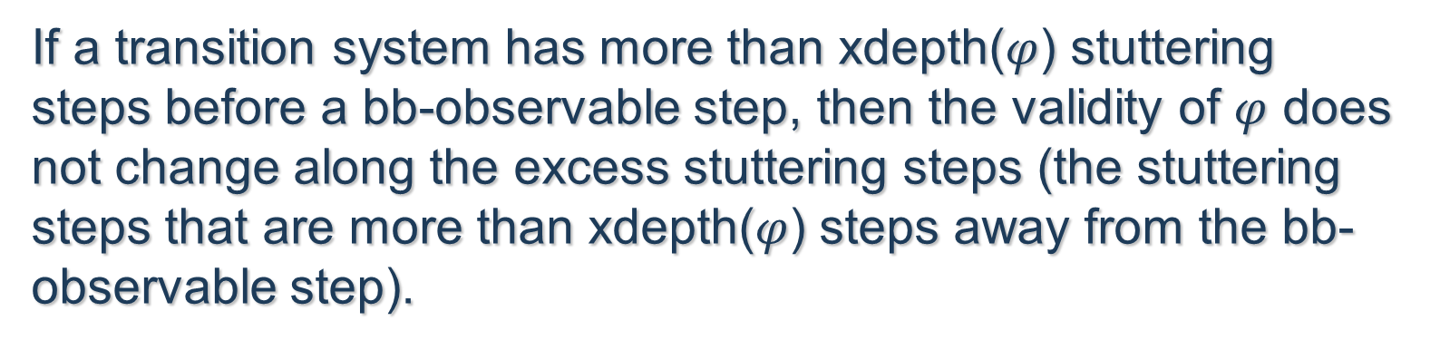
Relevant Stuttering Steps
If a transition system has more than xdepth($φ$) stuttering steps before a bb-observable step, then the validity of $φ$ does not change along the excess stuttering steps (the stuttering steps that are more than xdepth($φ$) steps away from the bb-observable step).

Slide 141
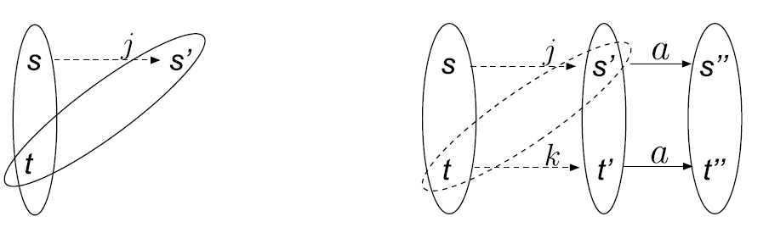
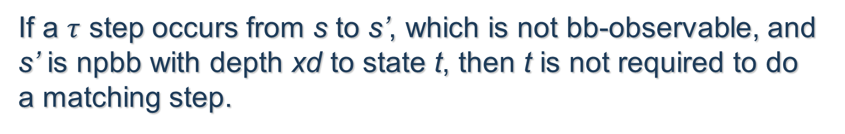
Next-preserving Branching Bisimulation
The solid ellipses represent next-preserving branching bisimulation.
If a $τ$ step occurs from s to s’, which is not bb-observable, and s’ is npbb with depth xd to state t, then t is not required to do a matching step.

Slide 142
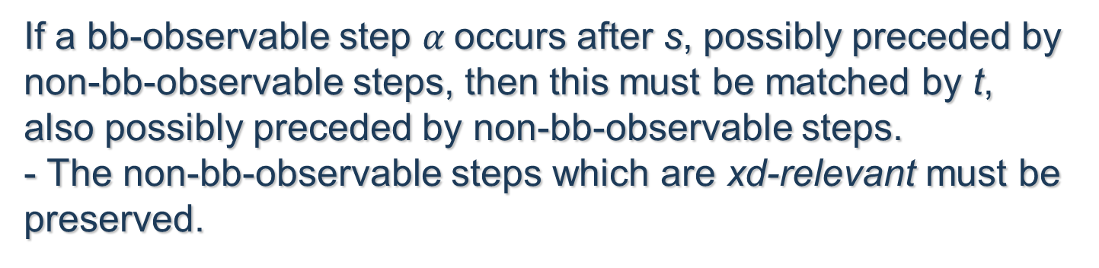

Next-preserving Branching Bisimulation
If a bb-observable step $α$occurs after s, possibly preceded by non-bb-observable steps, then this must be matched by t, also possibly preceded by non-bb-observable steps.
- The non-bb-observable steps which are xd-relevant must be preserved.

Slide 143
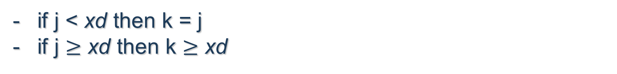
Next-preserving Branching Bisimulation
The dotted ellipse represents branching bisimulation with explicit divergence.
if j < xd then k = j
if j $≥$ xd then k $≥$ xd
Note that the relation is symmetric.

Slide 144
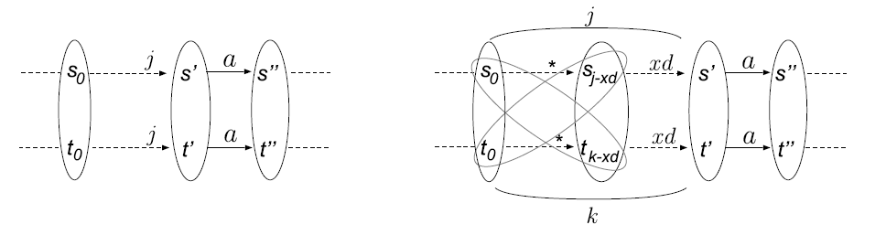
Next-preserving Branching Bisimulation
(Paths)
If j < xd, then all the stuttering steps are xd-relevant, so must be matched.
Otherwise, only xd stuttering steps must be matched.

Slide 145
Next-preserving Branching Bisimulation
(Paths)
This gives rise to an alternative definition using
xd-equivalent partitions.
Each xd-equivalent partition of a path has to be matched by an xd-equivalent partition in the other path.

Slide 146
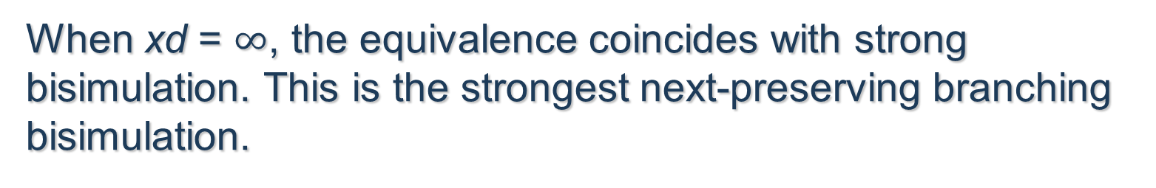
Next-preserving Branching Bisimulation
The parameterised next-preserving branching bisimulation gives rise to a heirarchy.
When xd = 0, the equivalence coincides with branching bisimulation with explicit divergence. This is the weakest next-preserving branching bisimulation.
When xd = $∞$, the equivalence coincides with strong bisimulation. This is the strongest next-preserving branching bisimulation.

Slide 147
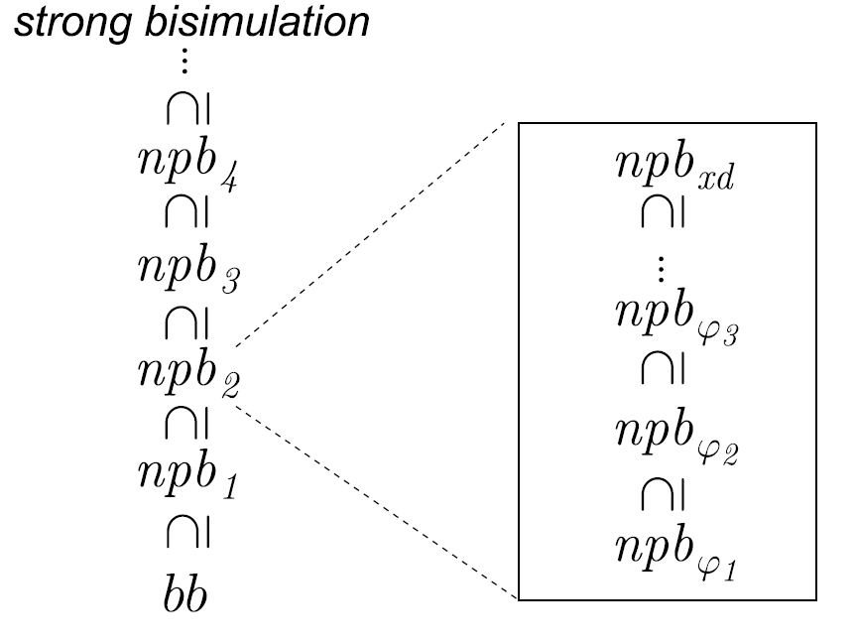
Next-preserving Branching Bisimulation

Slide 148
Next-preserving Slicing
The next-preserving branching bisimulation definition was used to create a slicing method that preserves CTL*.
- requires extra stuttering nodes to be kept in the slice.
- Extra nodes are placed before critical nodes and branching points in the transition system – equivalent to several constructs in the BT diagram, i.e. alternative branching, concurrent branching, conditional nodes.

Slide 149
Next-preserving Slicing
Alternative branching – need to look for cases where one branch leads to an observable node where the other doesn’t.
Concurrent branching – non-determinism arises from the interleaved execution of nodes in different threads
Therefore any node in a concurrent branch is a branching point
but most cases are not critical since they do not prevent the other nodes from executing

Slide 150
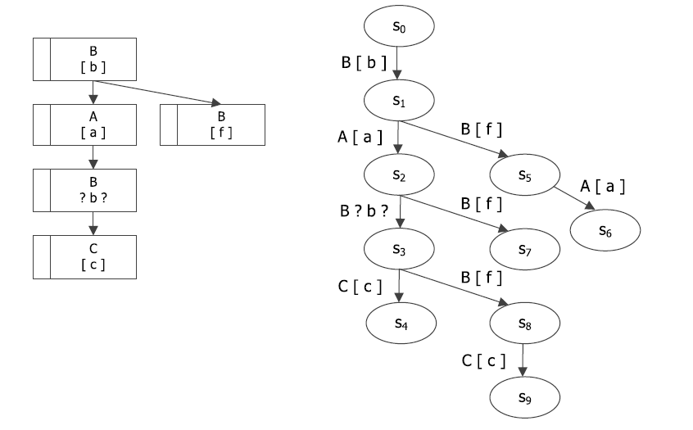
Next-preserving Slicing

Slide 151
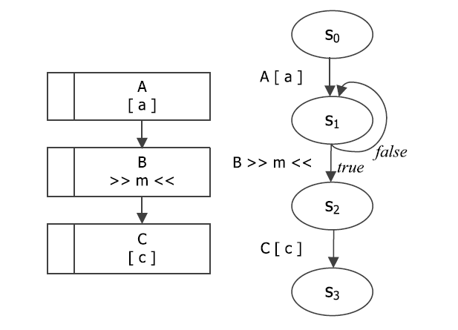
Next-preserving Slicing
Conditional nodes – not really branching in the transition system, except if it’s external input nodes.

Slide 152
Next-preserving Branching Bisimulation
- Proof of correctness that it preserves CTL* including X.
- Useful for applications where the X operator is required, e.g. slicing.

