Slide 1
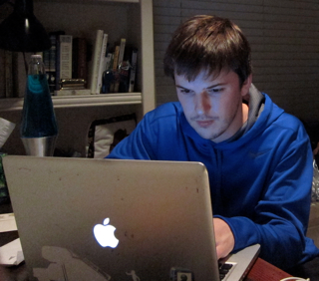
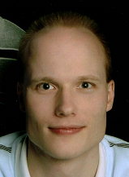
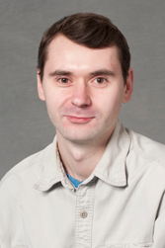
Focused Inference with Local Primal-Dual Gaps
Dhruv Batra (TTIC)
Joint work with:
Daniel Tarlow (U Toronto), Sebastian Nowozin (MSRC), Pushmeet Kohli (MSRC), Vladimir Kolmogorov (UCL)

Slide 2
Overview
Discrete Labelling Problems in Computer Vision
Focused Inference
Local Primal-Dual Gap
[Batra, Nowozin, Kohli AISTATS ‘11]
[Batra, Kohli CVPR ‘11]
[Tarlow, Batra, Kohli, Kolmogorov ICML ‘11]

Slide 3
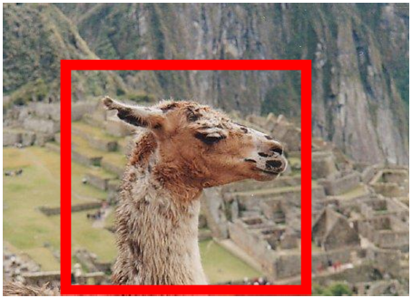
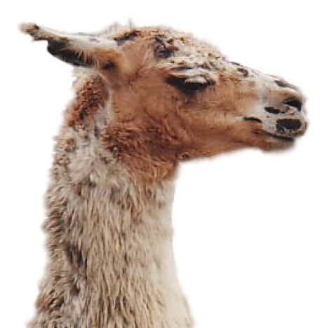
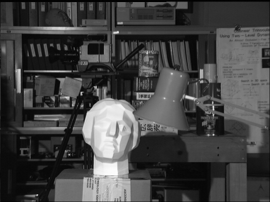
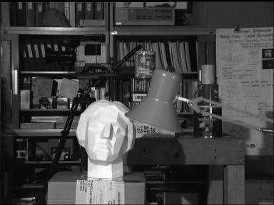
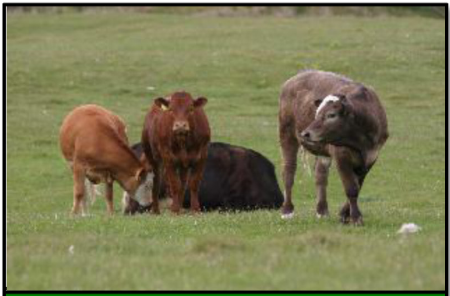
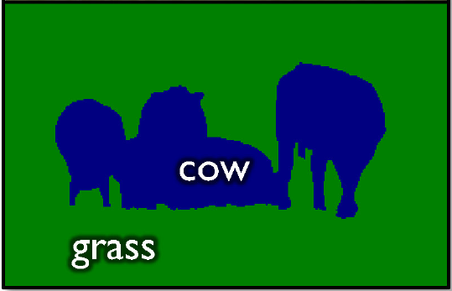
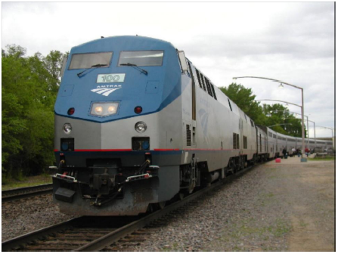
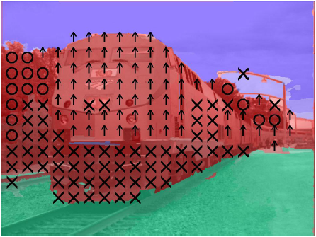
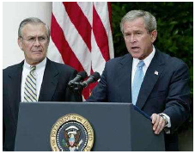
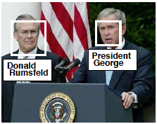
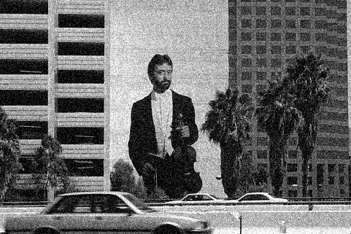
Labelling Problems in Vision
Segmentation
Stereo
Left image
Right image
Disparity map
Motion Flow
Geometric Labelling
Denoising
Name-Face Association

Slide 4
MAP Inference in MRFs
X₁
Set of discrete random variables
(Pairwise) Cost/Energy Function
MAP Inference
X₂
…
X_{n}
Node Energies / Local Costs
Edge Energies / Distributed Prior
kx1
kxk

Slide 5
Inference
MAP problem
In general NP-hard [Shimony ‘94]
Approximate Inference
Loopy BP [Pearl, ‘88]
α-Expansion [Boykov ’01, Komodakis ‘05]
LP Relaxations [Schlesinger ‘76, Wainwright ’05, Sontag ‘08]
Outer-Planar & High-order Decompositions [Batra ‘10, Kappes ‘10]

Slide 6
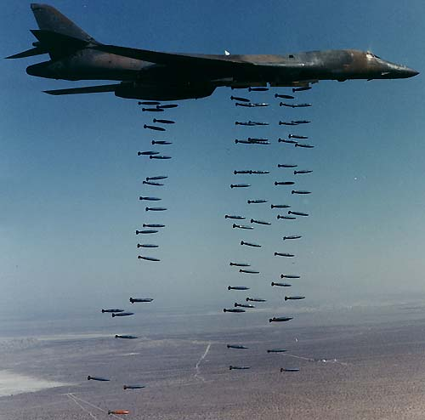
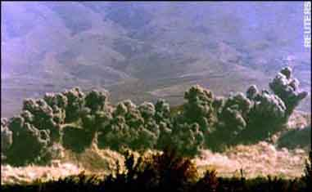
Approximate Inference
Carpet Bombing

Slide 7
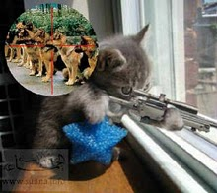
Focused Inference

Slide 8
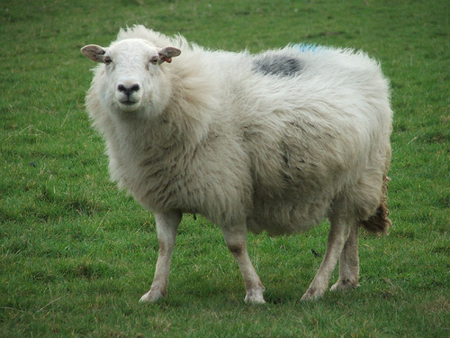
Focused Inference
Focused Inference
Energy-Aware Message-Passing ICML ‘11
Label Re-ordering in α-Expansion CVPR ‘11
Tightening LP Relaxations AISTATS ‘11
Ordering of Labels
Move Number | Classical Expansions | Our Guided Expansions
1 | Airplane | Sheep
2 | Bicycle | Dog
3 | Bird | Bird
4 | Boat | Cow
5 | Bottle | Cat

Slide 9
Common Theme
LP-relaxation
[Schlesinger ‘76, Koster ’98, Chekuri ‘01, Wainwright ’05]
Primal LP
Objective
Dual LP
Computation

Slide 10
Common Theme
LP-relaxation
[Schlesinger ‘76, Koster ’98, Chekuri ‘01, Wainwright ’05]
Local Primal-Dual Gaps
Primal contribution minus Dual Contribution
Distributed Primal-Dual Gap
Generalization of Complimentary Slackness Conditions
Objective
Current Primal-Dual Gap
Computation

Slide 11
MAP-MRF
Over-Complete Representation
kx1
k²x1

Slide 12
MAP-MRF
Energy
kx1
k²x1

Slide 13
MAP-MRF
Integer Program
Indicator Variables
Unique Label
Consistent Assignments

Slide 14
LP Relaxation
Linear Program
Tractable (but not scalable)

Slide 15
LP Relaxation
Linear Program --- Dual Program

Slide 16
LP Relaxation
Interpretation of Dual Program
Independently minimize terms
Subject to Reparameterization

Slide 17
LP Relaxation
Solving LP
Block Co-ordinate Ascent on Dual
Choose a block (set) of variables
Optimize block; fix rest
Repeat

Slide 18
LP Relaxation
Linear Program --- Dual Program
Complementary Slackness:

Slide 19
Local Primal-Dual Gap
Local Primal-Dual Gap
Defined for nodes & edges (higher order extensions later)
Contribution of each node and edge to the Primal-Dual Gap
Primal
Dual

Slide 20
Local Primal-Dual Gap
Intuition

Slide 21
Local Primal-Dual Gap
Properties
Decomposability
Quickly Computable
Sums to the total Primal-Dual Gap
Can easily define LPDG for sub-graphs
If no sub-graph with strictly positive LPDG exists, LP is tight

Slide 22
Focused Inference
Focused Inference
Energy-Aware Message-Passing ICML ‘11
Label Re-ordering in α-Expansion CVPR ‘11
Tightening LP Relaxations AISTATS ‘11
Ordering of Labels
Move Number | Classical Expansions | Our Guided Expansions
1 | Airplane | Sheep
2 | Bicycle | Dog
3 | Bird | Bird
4 | Boat | Cow
5 | Bottle | Cat

Slide 23
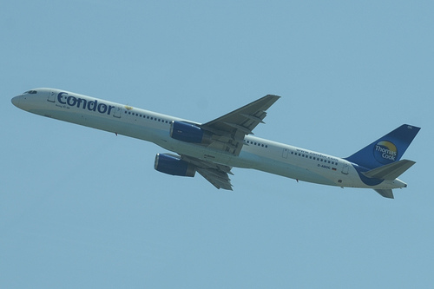
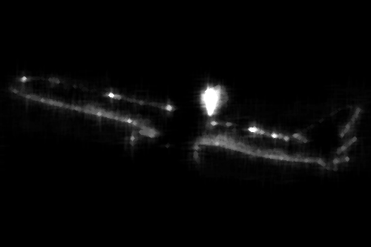
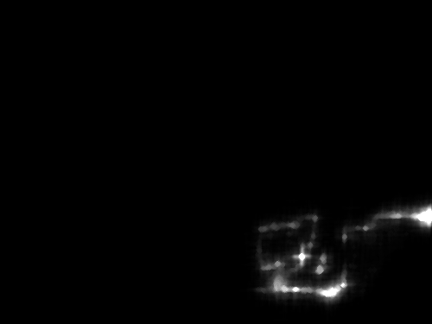
Focused Inference
Dynamic Tree Block Coordinate Ascent [ICML ‘11]
Image
Current Seg.
Update Mask
Updated Seg.
Messages

Slide 24
Focused Inference
Focused Inference
Energy-Aware Message-Passing ICML ‘11
Label Re-ordering in α-Expansion CVPR ‘11
Tightening LP Relaxations AISTATS ‘11
Ordering of Labels
Move Number | Classical Expansions | Our Guided Expansions
1 | Airplane | Sheep
2 | Bicycle | Dog
3 | Bird | Bird
4 | Boat | Cow
5 | Bottle | Cat

Slide 25
Dynamic Re-ordering of Blocks
Goal: Category Segmentation
α-Expansion solves the standard LP relaxation
Loop over α
Current Soln
2-Label Problem + GC
New Soln
α-Expansion
α

Slide 26
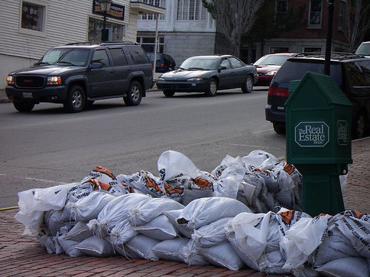
Dynamic Re-ordering of Blocks
Ordering of Labels
Move Number | Classical Expansions | Our Guided Expansions
Image 1
1 | Airplane | Car
2 | Bicycle | Person
3 | Bird | Motorbike
4 | Boat | Train
5 | Bottle | Airplane
Image 2
1 | Airplane | Sheep
2 | Bicycle | Dog
3 | Bird | Bird
4 | Boat | Cow
5 | Bottle | Cat

Slide 27
Dynamic Re-ordering of Blocks
LPDG score
For each node i, label
Primal
Dual

Slide 28
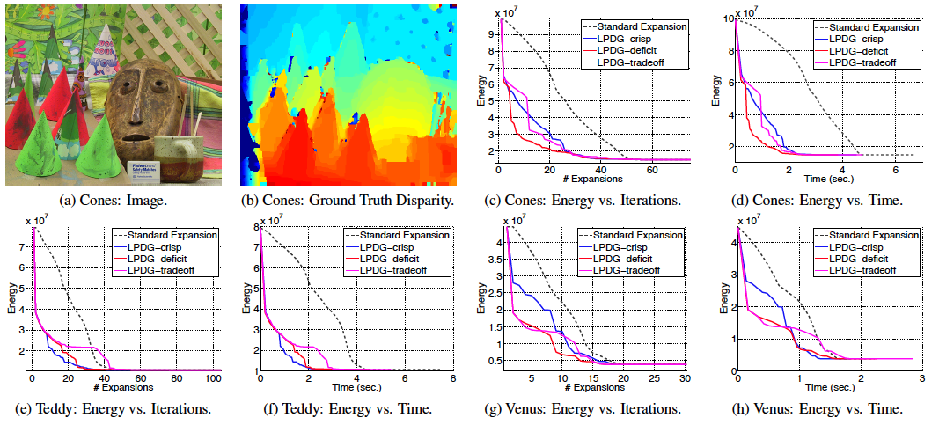
Experiments

Slide 29
Focused Inference
Focused Inference
Energy-Aware Message-Passing ICML ‘11
Label Re-ordering in α-Expansion CVPR ‘11
Tightening LP Relaxations AISTATS ‘11
Ordering of Labels
Move Number | Classical Expansions | Our Guided Expansions
1 | Airplane | Sheep
2 | Bicycle | Dog
3 | Bird | Bird
4 | Boat | Cow
5 | Bottle | Cat

Slide 30
LP Relaxation
LP-relaxation
[Schlesinger ‘76, Koster ’98, Chekuri ‘01, Wainwright ’05]
Primal LP
Objective
Dual LP
Computation

Slide 31
LP Relaxation
LP-relaxation
[Schlesinger ‘76, Koster ’98, Chekuri ‘01, Wainwright ’05]
Primal LP
Objective
Dual LP
Computation

Slide 32
Hierarchy of LPs
Increasingly Complex Sub-problems
Edge-Consistent LP
Triplet-Clique Consistent LP
LPDG to the rescue!
-- Score Clusters / Constraints -- Add high scoring ones

Slide 33
Experiments

Slide 34
Summary
Focused Inference vs. Energy-Agnostic Inference
Exploiting structure of the problem
First wave of success
Submodularity
Distance Transforms
Truncated Convex Potentials
Second wave of success
Focused Message Passing
Task Specific Computation

Slide 35
Thank You!

